Slide 1
YEZTUGO® (lenacapavir) for HIV-1 PrEP
Navigating the US Prescribing Information
Notes:
Guidance for Deck Usage:​
The deck must be presented sequentially and skipping sections is not permitted; all slides are required except for the quiz questions and appendix slides which are optional
The purpose of the quiz questions is to generate discussion for the speaker. These are optional
The slides contained in the appendix section are optional
​
Guidance for Distribution: The distributed version must include all slides.

Slide 2
Disclaimers
This non-promotional, proactive deck is intended to be used by Gilead Medical Affairs as educational material only.
This deck should only be presented by a Gilead employee, not a third-party speaker.
These slides provide only a summary and select sections of the FDA-approved YEZTUGO® US Prescribing Information.
Please see full Prescribing Information for YEZTUGO, including Boxed Warning, available at Gilead.com.

Slide 3
Boxed Warning
WARNING: RISK OF DRUG RESISTANCE WITH USE OF YEZTUGO FOR
HIV-1 PrEP IN UNDIAGNOSED HIV-1 INFECTION
Individuals must be tested for HIV-1 infection prior to initiating YEZTUGO, and with each subsequent injection of YEZTUGO, using a test approved or cleared by the FDA for the diagnosis of acute or primary HIV-1 infection. Drug-resistant HIV-1 variants have been identified with use of YEZTUGO by individuals with undiagnosed HIV-1 infection. Do not initiate YEZTUGO unless negative infection status is confirmed. Individuals who acquire HIV-1 while receiving YEZTUGO must transition to a complete HIV-1 treatment regimen.
[see Dosage and Administration (2.1), Contraindications (4) and Warnings and Precautions (5.1, 5.2)]

Slide 4
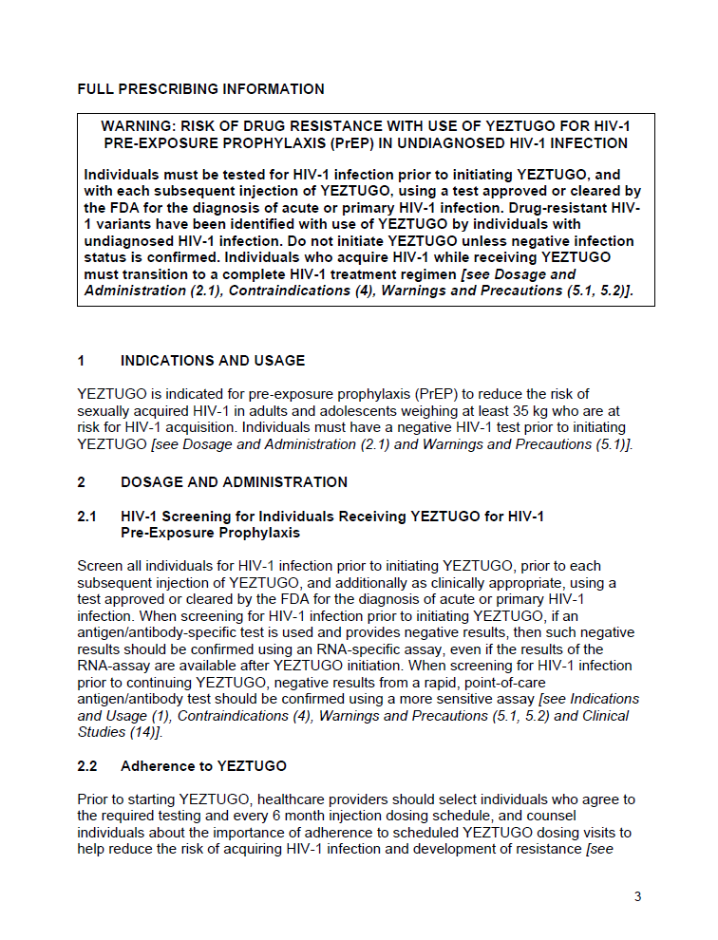
1. Indications and Usage
1  Indications and Usage
YEZTUGO is indicated for PrEP to reduce the risk of sexually acquired HIV-1 in adults and adolescents weighing ≥35 kg who are at risk for HIV-1 acquisition.
Individuals must have a negative HIV-1 test result prior to initiating YEZTUGO.
[see Dosage and Administration (2.1) and Warnings and Precautions (5.1)]
Notes:
MAIN MESSAGE
LEN is indicated for PrEP to reduce the risk of sexually acquired HIV-1 in adults and adolescents weighing ≥35 kg who are at risk for HIV-1 acquisition. Individuals must have a negative HIV-1 test prior to initiating YEZTUGO
BACKGROUND
Mechanism of action:
YEZTUGO is an HIV-1 antiretroviral agent with long-acting properties [see Microbiology (12.4)]
LEN inhibits HIV-1 replication by interfering with multiple essential steps of the viral lifecycle, including:
Capsid-mediated nuclear uptake of HIV-1 proviral DNA (by blocking nuclear import proteins binding to capsid)
Virus assembly and release (by interfering with Gag/Gag-Pol functioning, reducing production of capsid protein subunits)
Capsid core formation (by disrupting the rate of capsid subunit association, leading to malformed capsids)

Slide 5
2. Dosage and Administration
2.1  HIV-1 Screening for Individuals Receiving YEZTUGO
Screen all individuals for HIV-1 prior to initiating YEZTUGO, prior to each subsequent injection of YEZTUGO, and additionally as clinically appropriate, using a test approved or cleared by the FDA for the diagnosis of acute or primary HIV-1 infection. [see Indications and Usage (1), Contraindications (4) and Warnings and Precautions (5.1, 5.2) and Clinical Studies (14)]
Prior to initiating YEZTUGO: Negative result from an Ag/Ab-specific test should be confirmed using an RNA-specific assay.ª
Prior to continuing YEZTUGO: Negative result from a rapid, point-of-care
Ag/Ab test should be confirmed using a more sensitive assay.
2.2  Adherence to YEZTUGO
Prior to starting YEZTUGO, healthcare providers should select individuals who agree to the required testing and Q6M injection dosing schedule, and counsel individuals about the importance of adherence to scheduled YEZTUGO dosing visits.
[see Dosage and Administration (2.1), Warnings and Precautions (5.1, 5.2) and Microbiology (12.4)]
ªEven if the results of the RNA-assay are available after YEZTUGO initiation
Ag/Ab, antigen/antibody; Q6M, every 6 months
Notes:
MAIN MESSAGES
Individuals should be screened for HIV-1 prior to initiating LEN, prior to each subsequent injection of YEZTUGO and additionally as clinically appropriate
Adherence education should be provided in counseling to ensure individuals are informed about the importance of dose scheduling adherence

Slide 6
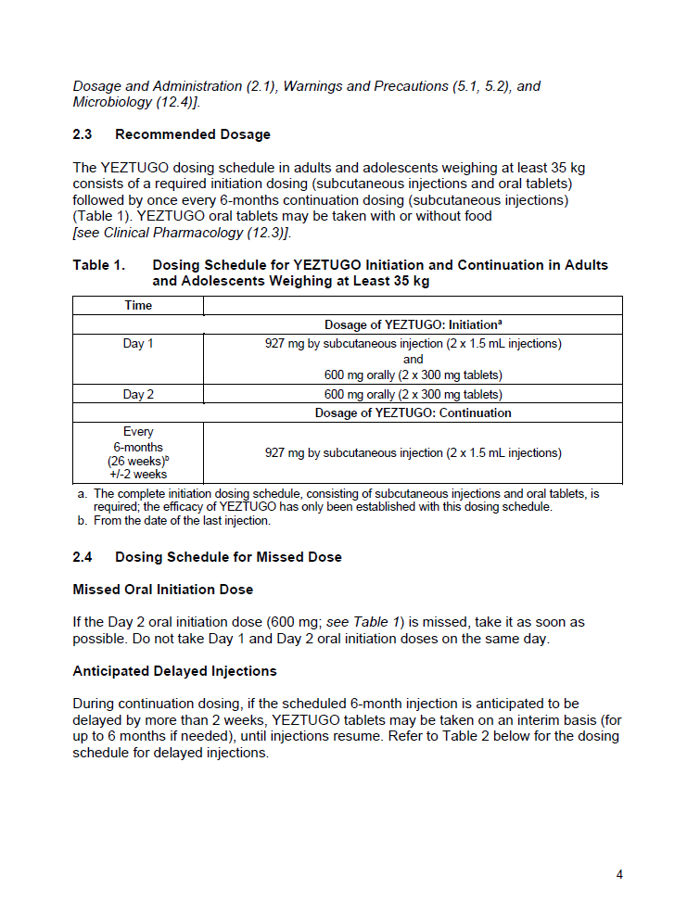
2. Dosage and Administration
2.3  Recommended Dosage
The YEZTUGO dosing schedule in adults and adolescents weighing ≥35 kg consists of a required initiation dosing (SC injections and oral tablets) followed by Q6M continuation dosing (SC injections) (Table 1).
YEZTUGO oral tablets may be taken with or without food.
[see Clinical Pharmacology (12.3)]
Table 1. Dosing Schedule for YEZTUGO Initiation and Continuationª
Time
 | Dosage of YEZTUGO: Initiation^{b}
Day 1 | 927 mg by SC injection (2 × 1.5 mL injections) 600 mg orally (2 × 300 mg tablets)
Day 2 | 600 mg orally (2 × 300 mg tablets)
 | Dosage of YEZTUGO: Continuation
Q6M (Q26W)^{c} ±2 weeks | 927 mg by SC injection (2 × 1.5 mL injections)
ªDosing schedule for initiation and continuation in adults and adolescents weighing ≥35 kg; ^{b}The complete initiation dosing schedule, consisting of SC injections and oral tablets, is required. The efficacy of YEZTUGO has only been established with this dosing schedule; ^{c}From date of last injection
Q6M, every 6 months; Q26W, every 26 weeks
Notes:
MAIN MESSAGES
On Day 1, the individual receives LEN SC injection + oral tablets
On Day 2, the individual receives LEN oral tablets
Q6M thereafter, the individual receives continuation LEN SC injections
Note: Q6M/Q26W has a window of ±2 weeks

Slide 7
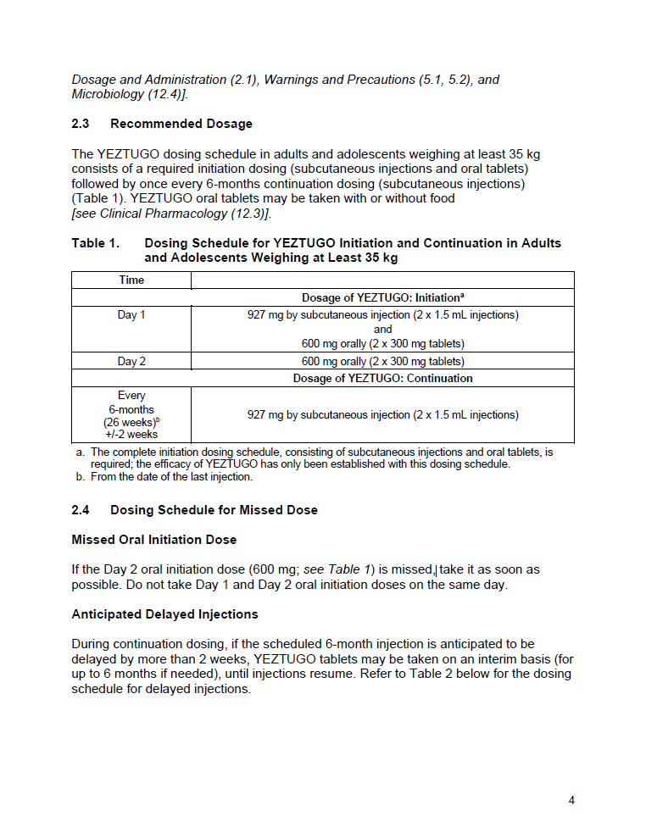
2. Dosage and Administration
2.4  Missed Oral Initiation Dose
If the Day 2 oral initiation dose (600 mg; see Table 1) is missed:
Take it as soon as possible. Do not take Day 1 and Day 2 oral initiation doses on the same day.
2.4  Anticipated Delayed Injections
During continuation dosing, if the scheduled 6-month injection is anticipated to be
delayed by more than 2 weeks:
Oral dosing of YEZTUGO tablets may be taken on an interim basis (300 mg Q7D, for up to 6 months if needed), until injections resume. Continuation injection dosage should be resumed within 7 days after the last oral dose.
Q7D, every 7 days
Notes:
MAIN MESSAGES
Adherence to the injection dosing schedule is strongly recommended
If the Day 2 oral initiation dose (600 mg; see Table 1) is missed, take it as soon as possible. Do not take Day 1 and Day 2 oral initiation doses on the same day
If injection delay of >2 weeks are anticipated, the individual should be placed on weekly oral tablets on an interim basis, for up to 6 months if needed

Slide 8
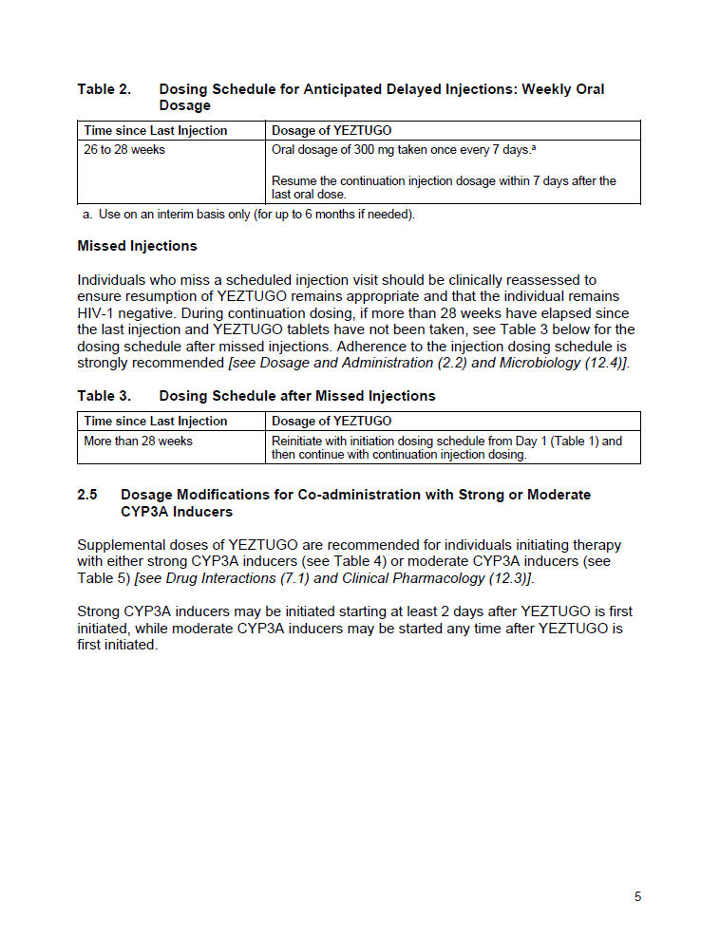
2. Dosage and Administration
2.4  Missed Injections
Individuals who miss a scheduled injection visit should be clinically reassessed to ensure that the individual remains HIV-1 negative and resumption of YEZTUGO remains appropriate.
During continuation dosing, if more than 28 weeks have elapsed since the last injection and YEZTUGO tablets have not been taken:
Reinitiate with initiation dosing schedule from Day 1 (Table 1) and then continue with continuation injection dosing.
[see Dosage and Administration (2.2) and Microbiology (12.4)]
Notes:
MAIN MESSAGES
Adherence to the injection dosing schedule is strongly recommended
During continuation dosing, if more than 28 weeks have elapsed since the last injection and oral tablets have not been taken, the individual will need reassessment
If the individual remains HIV-1 negative, the initiation dosing schedule from Day 1 (Table 1) should be reinitiated, followed by continuation injection dosing

Slide 9

2. Dosage and Administration
2.5  Dosage Modifications for Co-administration with Strong or Moderate CYP3A Inducers
Supplemental doses of YEZTUGO are recommended for individuals initiating therapy with either strong or moderate CYP3A inducers (Table 4 and Table 5).
[see Drug Interactions (7.1) and Clinical Pharmacology (12.3)]
Strong CYP3A inducers may be initiated starting at least 2 days after YEZTUGO is first initiated
Moderate CYP3A inducers may be started any time after YEZTUGO is first initiated
CYP3A, cytochrome (P450) 3A
Notes:
MAIN MESSAGES
Supplemental doses of YEZTUGO are recommended for individuals initiating therapy with either strong or moderate CYP3A inducers

Slide 10
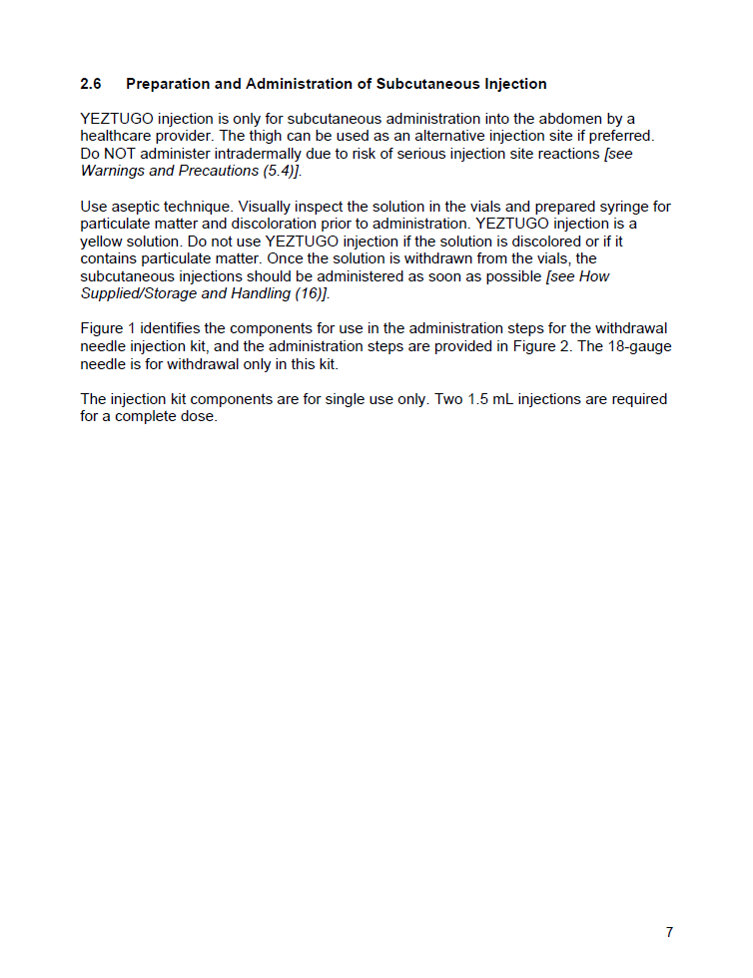
2. Dosage and Administration
2.6  Preparation and Administration of Subcutaneous Injection
YEZTUGO injection is only for SC administration into the abdomen by a healthcare provider. The thigh can be used as an alternative injection site if preferred. Do NOT administer intradermally due to risk of serious ISRs.
[see Warnings and Precautions (5.4)]
Use aseptic technique. Visually inspect the solution in the vials and prepared syringe for particulate matter and discoloration prior to administration. YEZTUGO injection is a yellow solution. Do not use YEZTUGO injection if the solution is discolored or if it contains particulate matter. Once the solution is withdrawn from the vials, the SC injections should be administered as soon as possible.
[see How Supplied/Storage and Handling (16)]
ISR, injection-site reaction
Notes:
MAIN MESSAGES
LEN is for SC administration into the abdomen by a healthcare provider
The thigh can be used as an alternative injection site if preferred
Use aseptic technique for preparation
Be sure to inspect vials for any particulate matter or discoloration; do not use if found

Slide 11
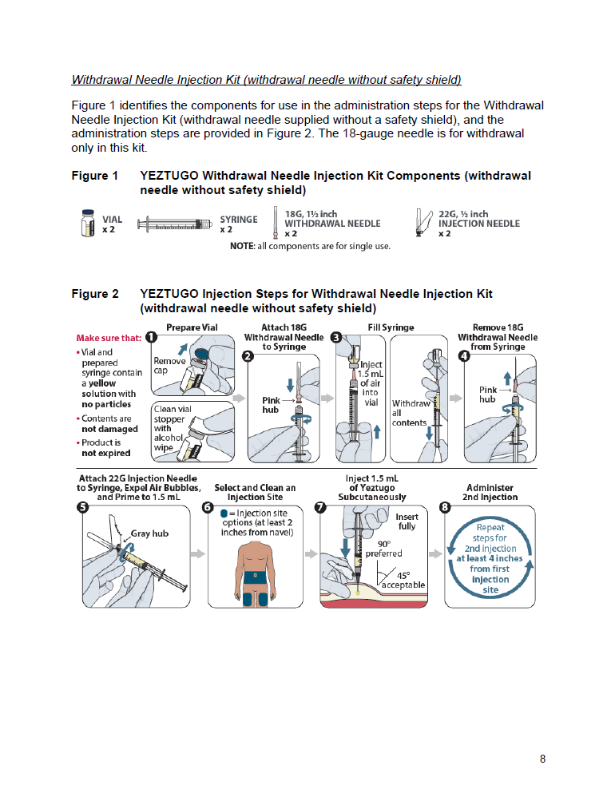
2. Dosage and Administration
Figure 1  YEZTUGO Withdrawal Needle Injection Kit Components
(withdrawal needle without safety shield)
Figure 1 identifies the components for use in the administration steps for the Withdrawal Needle Injection Kit (withdrawal needle supplied without a safety shield), and the administration steps are provided in Figure 2 (next slide). The 18G needle is for withdrawal only in this kit. Two 1.5 mL injections are required for a complete dose.
Figure 1: YEZTUGO Withdrawal Needle Injection Kit Components (withdrawal needle without safety shield)
The Withdrawal Needle Injection Kit contains withdrawal needles that may be supplied with or without a safety shield. The presence or absence of a safety shield does not change how YEZTUGO injection is prepared
VIAL
×2
SYRINGE
×2
18G, 1½ inch WITHDRAWAL NEEDLE
×2
22G, ½ inch
INJECTION NEEDLE
×2
NOTE: All components are for single use.
G, gauge
Notes:
MAIN MESSAGE
The components for use in the administration steps for the withdrawal needle injection kit (withdrawal needle without safety shield) include: two vials, two syringes, two 18G withdrawal needles and two 22G injection needles
BACKGROUND
Each single-dose vial contains 463.5 mg/1.5 mL (309 mg/mL) of LEN (present as 473.1 mg/1.5 mL of LEN sodium)
The LEN injectable solution is sterile, preservative free, clear and yellow, with no visible particles
Make sure that:
Vial and prepared syringe contain a yellow solution with no particles
Contents are not damaged
Product is not expired

Slide 12
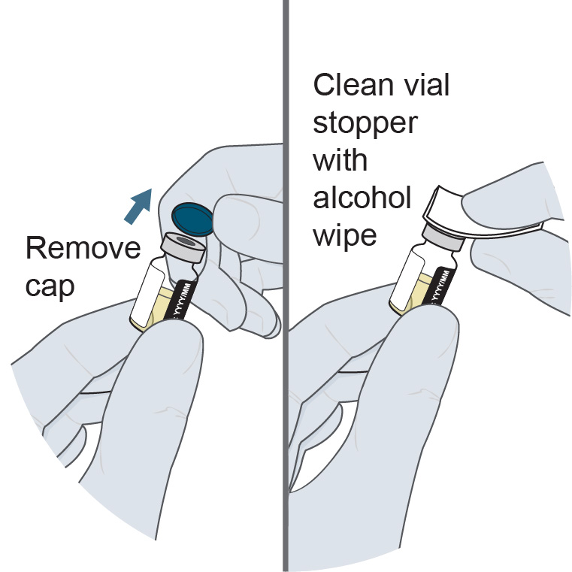
2. Dosage and Administration
Figure 2  YEZTUGO Injection Steps for Withdrawal Needle Injection Kit
(withdrawal needle without safety shield)
1. Prepare vial
Notes:
MAIN MESSAGE
The 8-step administration procedure for YEZTUGO is displayed on the slide (withdrawal needle without safety shield)
BACKGROUND
Two 1.5-mL injections are required for a complete dose
A SC drug depot forms following YEZTUGO injection. This may lead to a nodule at the injection site in some individuals [see Adverse Reactions (6.1) and Clinical Pharmacology (12.3)]

Slide 13
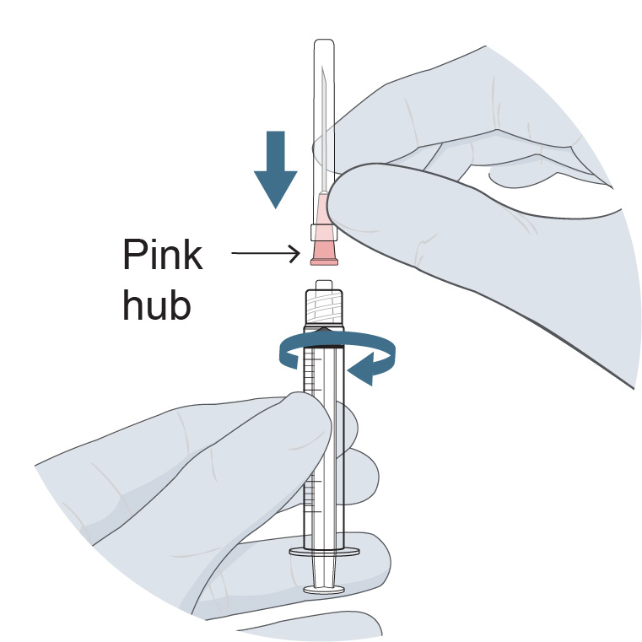
2. Dosage and Administration
Figure 2  YEZTUGO Injection Steps for Withdrawal Needle Injection Kit
(withdrawal needle without safety shield)
1. Prepare vial
2. Attach 18G withdrawal needle to syringe
G, gauge
Notes:
MAIN MESSAGE
The 8-step administration procedure for YEZTUGO is displayed on the slide (withdrawal needle without safety shield)
BACKGROUND
Two 1.5-mL injections are required for a complete dose
A SC drug depot forms following YEZTUGO injection. This may lead to a nodule at the injection site in some individuals [see Adverse Reactions (6.1) and Clinical Pharmacology (12.3)]

Slide 14
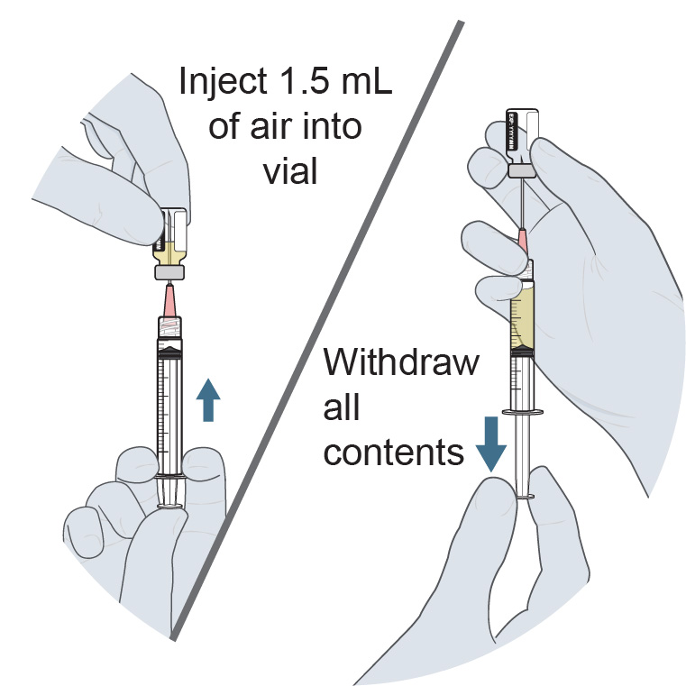
2. Dosage and Administration
Figure 2  YEZTUGO Injection Steps for Withdrawal Needle Injection Kit
(withdrawal needle without safety shield)
1. Prepare vial
2. Attach 18G withdrawal needle to syringe
3. Fill syringe
G, gauge
Notes:
MAIN MESSAGE
The 8-step administration procedure for YEZTUGO is displayed on the slide (withdrawal needle without safety shield)
BACKGROUND
Two 1.5-mL injections are required for a complete dose
A SC drug depot forms following YEZTUGO injection. This may lead to a nodule at the injection site in some individuals [see Adverse Reactions (6.1) and Clinical Pharmacology (12.3)]

Slide 15
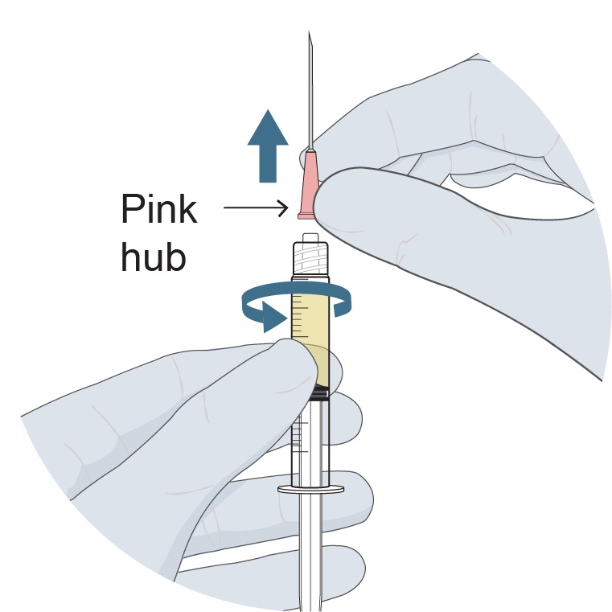
2. Dosage and Administration
Figure 2  YEZTUGO Injection Steps for Withdrawal Needle Injection Kit
(withdrawal needle without safety shield)
1. Prepare vial
2. Attach 18G withdrawal needle to syringe
3. Fill syringe
4. Remove 18G withdrawal needle from syringe
G, gauge
Notes:
MAIN MESSAGE
The 8-step administration procedure for YEZTUGO is displayed on the slide (withdrawal needle without safety shield)
BACKGROUND
Two 1.5-mL injections are required for a complete dose
A SC drug depot forms following YEZTUGO injection. This may lead to a nodule at the injection site in some individuals [see Adverse Reactions (6.1) and Clinical Pharmacology (12.3)]

Slide 16
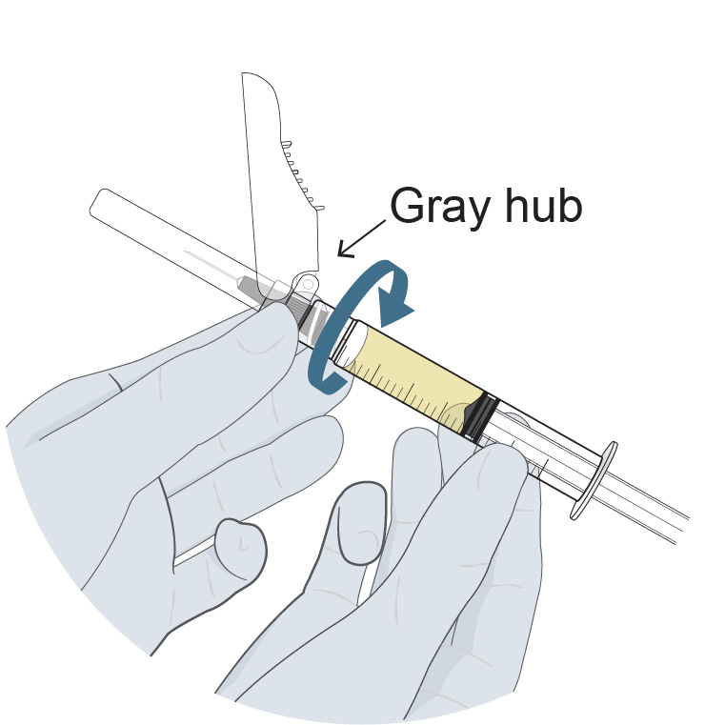
2. Dosage and Administration
Figure 2  YEZTUGO Injection Steps for Withdrawal Needle Injection Kit
(withdrawal needle without safety shield)
1. Prepare vial
2. Attach 18G withdrawal needle to syringe
3. Fill syringe
4. Remove 18G withdrawal needle from syringe
5. Attach 22G injection needle to syringe,
expel air bubbles, and prime to 1.5 mL
G, gauge
Notes:
MAIN MESSAGE
The 8-step administration procedure for YEZTUGO is displayed on the slide (withdrawal needle without safety shield)
BACKGROUND
Two 1.5-mL injections are required for a complete dose
A SC drug depot forms following YEZTUGO injection. This may lead to a nodule at the injection site in some individuals [see Adverse Reactions (6.1) and Clinical Pharmacology (12.3)]

Slide 17
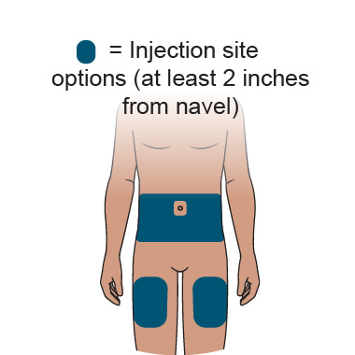
2. Dosage and Administration
Figure 2  YEZTUGO Injection Steps for Withdrawal Needle Injection Kit
(withdrawal needle without safety shield)
1. Prepare vial
2. Attach 18G withdrawal needle to syringe
3. Fill syringe
4. Remove 18G withdrawal needle from syringe
5. Attach 22G injection needle to syringe,
expel air bubbles, and prime to 1.5 mL
6. Select and clean an injection site
G, gauge
Notes:
MAIN MESSAGE
The 8-step administration procedure for YEZTUGO is displayed on the slide (withdrawal needle without safety shield)
BACKGROUND
Two 1.5-mL injections are required for a complete dose
A SC drug depot forms following YEZTUGO injection. This may lead to a nodule at the injection site in some individuals [see Adverse Reactions (6.1) and Clinical Pharmacology (12.3)]

Slide 18
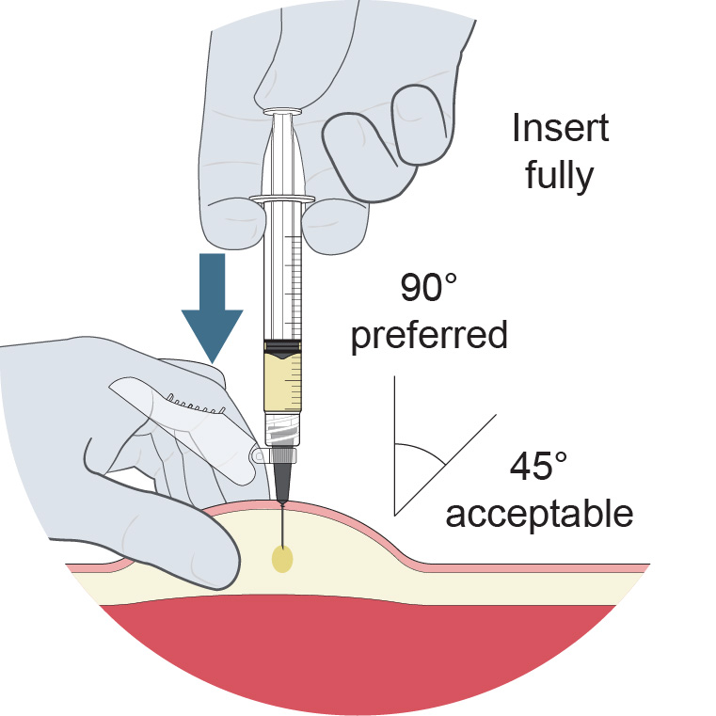
2. Dosage and Administration
Figure 2  YEZTUGO Injection Steps for Withdrawal Needle Injection Kit
(withdrawal needle without safety shield)
1. Prepare vial
2. Attach 18G withdrawal needle to syringe
3. Fill syringe
4. Remove 18G withdrawal needle from syringe
5. Attach 22G injection needle to syringe,
expel air bubbles, and prime to 1.5 mL
6. Select and clean an injection site
7. Inject 1.5 mL of YEZTUGO subcutaneously (needle angle to skin: 45–90°, 90° preferred)
G, gauge
Notes:
MAIN MESSAGE
The 8-step administration procedure for YEZTUGO is displayed on the slide (withdrawal needle without safety shield)
BACKGROUND
Two 1.5-mL injections are required for a complete dose
A SC drug depot forms following YEZTUGO injection. This may lead to a nodule at the injection site in some individuals [see Adverse Reactions (6.1) and Clinical Pharmacology (12.3)]

Slide 19
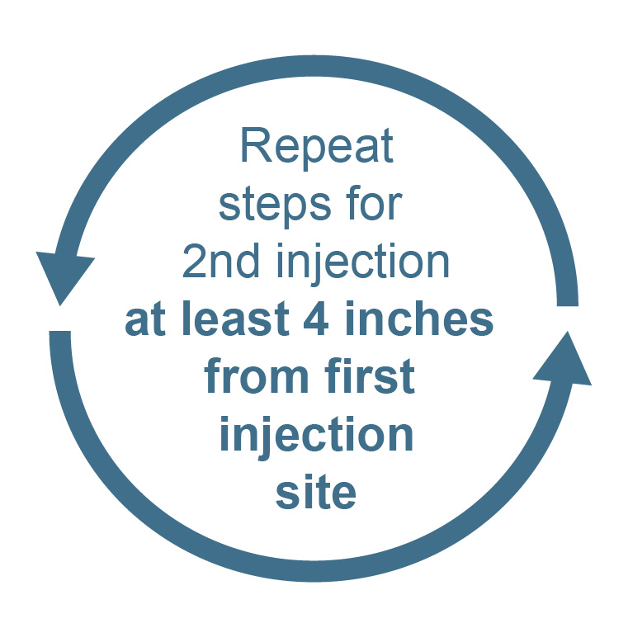
2. Dosage and Administration
Figure 2  YEZTUGO Injection Steps for Withdrawal Needle Injection Kit
(withdrawal needle without safety shield)
1. Prepare vial
2. Attach 18G withdrawal needle to syringe
3. Fill syringe
4. Remove 18G withdrawal needle from syringe
5. Attach 22G injection needle to syringe,
expel air bubbles, and prime to 1.5 mL
6. Select and clean an injection site
7. Inject 1.5 mL of YEZTUGO subcutaneously (needle angle to skin: 45–90°, 90° preferred)
8. Administer second injection
G, gauge
Notes:
MAIN MESSAGE
The 8-step administration procedure for YEZTUGO is displayed on the slide (withdrawal needle without safety shield)
BACKGROUND
Two 1.5-mL injections are required for a complete dose
A SC drug depot forms following YEZTUGO injection. This may lead to a nodule at the injection site in some individuals [see Adverse Reactions (6.1) and Clinical Pharmacology (12.3)]

Slide 20
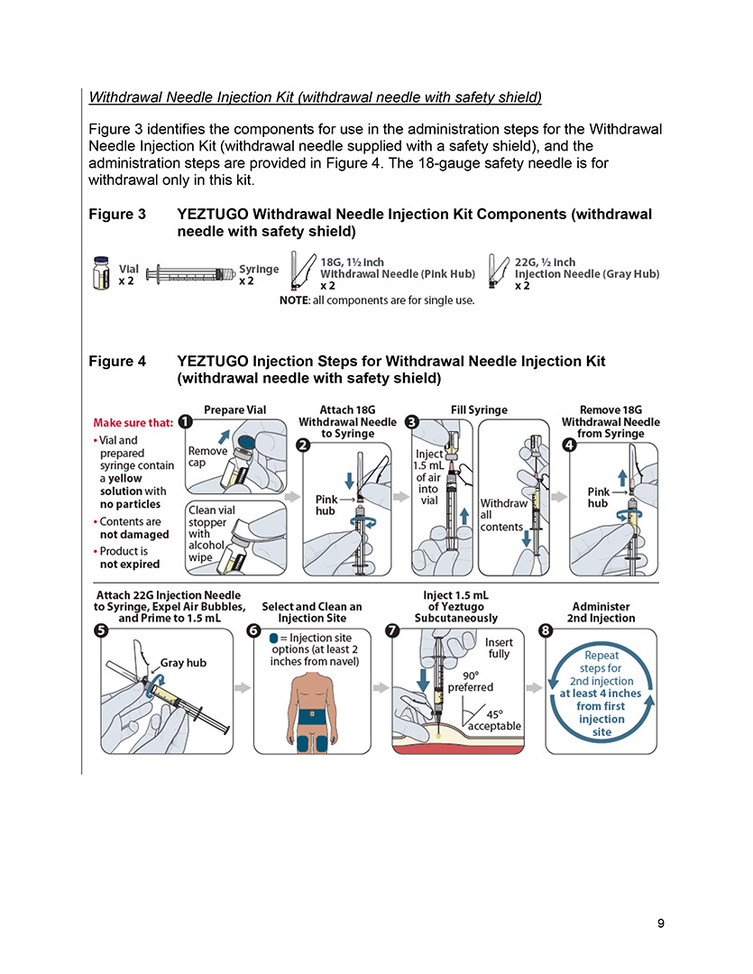
2. Dosage and Administration
Figure 3  YEZTUGO Withdrawal Needle Injection Kit Components
(withdrawal needle with safety shield)
Figure 3 identifies the components for use in the administration steps for the Withdrawal Needle Injection Kit (withdrawal needle supplied with a safety shield), and the administration steps are provided in Figure 4. The 18G safety needle is for withdrawal only in this kit.
Figure 3: YEZTUGO Withdrawal Needle Injection Kit Components (withdrawal needle with safety shield)
The Withdrawal Needle Injection Kit contains withdrawal needles that may be supplied with or without a safety shield. The presence or absence of a safety shield does not change how YEZTUGO injection is prepared
VIAL
×2
SYRINGE
×2
18G, 1½ inch WITHDRAWAL NEEDLE (pink hub)
×2
22G, ½ inch
INJECTION NEEDLE (gray hub)
×2
NOTE: All components are for single use.
G, gauge
Notes:
MAIN MESSAGE
The components for use in the administration steps for the withdrawal needle injection kit (withdrawal needle with safety shield) include: two vials, two syringes, two 18G withdrawal needles and two 22G injection needles
BACKGROUND
Each single-dose vial contains 463.5 mg/1.5 mL (309 mg/mL) of LEN (present as 473.1 mg/1.5 mL of LEN sodium)
The LEN injectable solution is sterile, preservative free, clear and yellow, with no visible particles
Make sure that:
Vial and prepared syringe contain a yellow solution with no particles
Contents are not damaged
Product is not expired

Slide 21
2. Dosage and Administration
Figure 4  YEZTUGO Injection Steps for Withdrawal Needle Injection Kit
(withdrawal needle with safety shield)
1. Prepare vial
Notes:
MAIN MESSAGE
The 8-step administration procedure for YEZTUGO is displayed on the slide (withdrawal needle with safety shield)
BACKGROUND
Two 1.5-mL injections are required for a complete dose
A SC drug depot forms following YEZTUGO injection. This may lead to a nodule at the injection site in some individuals [see Adverse Reactions (6.1) and Clinical Pharmacology (12.3)]

Slide 22
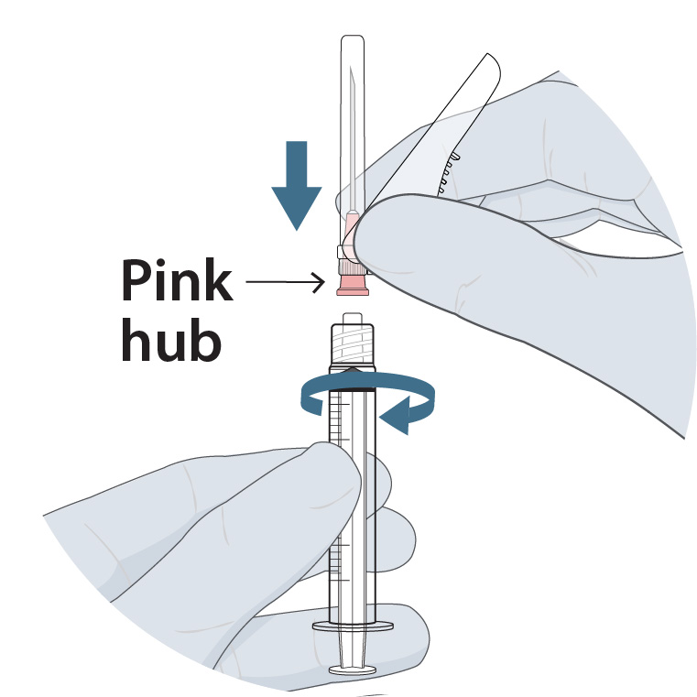
2. Dosage and Administration
Figure 4  YEZTUGO Injection Steps for Withdrawal Needle Injection Kit
(withdrawal needle with safety shield)
1. Prepare vial
2. Attach 18G withdrawal needle to syringe
G, gauge
Notes:
MAIN MESSAGE
The 8-step administration procedure for YEZTUGO is displayed on the slide (withdrawal needle with safety shield)
BACKGROUND
Two 1.5-mL injections are required for a complete dose
A SC drug depot forms following YEZTUGO injection. This may lead to a nodule at the injection site in some individuals [see Adverse Reactions (6.1) and Clinical Pharmacology (12.3)]

Slide 23
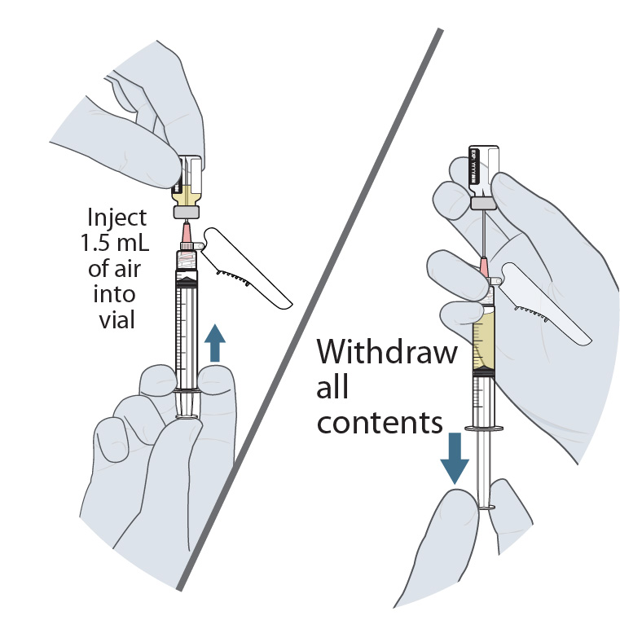
2. Dosage and Administration
Figure 4  YEZTUGO Injection Steps for Withdrawal Needle Injection Kit
(withdrawal needle with safety shield)
1. Prepare vial
2. Attach 18G withdrawal needle to syringe
3. Fill syringe
G, gauge
Notes:
MAIN MESSAGE
The 8-step administration procedure for YEZTUGO is displayed on the slide (withdrawal needle with safety shield)
BACKGROUND
Two 1.5-mL injections are required for a complete dose
A SC drug depot forms following YEZTUGO injection. This may lead to a nodule at the injection site in some individuals [see Adverse Reactions (6.1) and Clinical Pharmacology (12.3)]

Slide 24
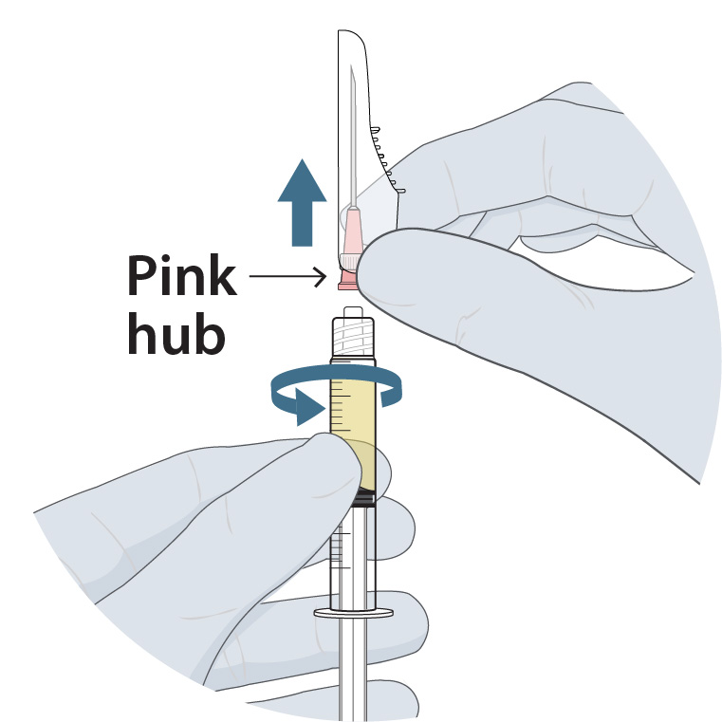
2. Dosage and Administration
Figure 4  YEZTUGO Injection Steps for Withdrawal Needle Injection Kit
(withdrawal needle with safety shield)
1. Prepare vial
2. Attach 18G withdrawal needle to syringe
3. Fill syringe
4. Remove 18G withdrawal needle from syringe
G, gauge
Notes:
MAIN MESSAGE
The 8-step administration procedure for YEZTUGO is displayed on the slide (withdrawal needle with safety shield)
BACKGROUND
Two 1.5-mL injections are required for a complete dose
A SC drug depot forms following YEZTUGO injection. This may lead to a nodule at the injection site in some individuals [see Adverse Reactions (6.1) and Clinical Pharmacology (12.3)]

Slide 25
2. Dosage and Administration
Figure 4  YEZTUGO Injection Steps for Withdrawal Needle Injection Kit
(withdrawal needle with safety shield)
1. Prepare vial
2. Attach 18G withdrawal needle to syringe
3. Fill syringe
4. Remove 18G withdrawal needle from syringe
5. Attach 22G injection needle to syringe,
expel air bubbles, and prime to 1.5 mL
G, gauge
Notes:
MAIN MESSAGE
The 8-step administration procedure for YEZTUGO is displayed on the slide (withdrawal needle with safety shield)
BACKGROUND
Two 1.5-mL injections are required for a complete dose
A SC drug depot forms following YEZTUGO injection. This may lead to a nodule at the injection site in some individuals [see Adverse Reactions (6.1) and Clinical Pharmacology (12.3)]

Slide 26
2. Dosage and Administration
Figure 4  YEZTUGO Injection Steps for Withdrawal Needle Injection Kit
(withdrawal needle with safety shield)
1. Prepare vial
2. Attach 18G withdrawal needle to syringe
3. Fill syringe
4. Remove 18G withdrawal needle from syringe
5. Attach 22G injection needle to syringe,
expel air bubbles, and prime to 1.5 mL
6. Select and clean an injection site
G, gauge
Notes:
MAIN MESSAGE
The 8-step administration procedure for YEZTUGO is displayed on the slide (withdrawal needle with safety shield)
BACKGROUND
Two 1.5-mL injections are required for a complete dose
A SC drug depot forms following YEZTUGO injection. This may lead to a nodule at the injection site in some individuals [see Adverse Reactions (6.1) and Clinical Pharmacology (12.3)]

Slide 27
2. Dosage and Administration
Figure 4  YEZTUGO Injection Steps for Withdrawal Needle Injection Kit
(withdrawal needle with safety shield)
1. Prepare vial
2. Attach 18G withdrawal needle to syringe
3. Fill syringe
4. Remove 18G withdrawal needle from syringe
5. Attach 22G injection needle to syringe,
expel air bubbles, and prime to 1.5 mL
6. Select and clean an injection site
7. Inject 1.5 mL of YEZTUGO subcutaneously (needle angle to skin: 45–90°, 90° preferred)
G, gauge
Notes:
MAIN MESSAGE
The 8-step administration procedure for YEZTUGO is displayed on the slide (withdrawal needle with safety shield)
BACKGROUND
Two 1.5-mL injections are required for a complete dose
A SC drug depot forms following YEZTUGO injection. This may lead to a nodule at the injection site in some individuals [see Adverse Reactions (6.1) and Clinical Pharmacology (12.3)]

Slide 28
2. Dosage and Administration
Figure 4  YEZTUGO Injection Steps for Withdrawal Needle Injection Kit
(withdrawal needle with safety shield)
1. Prepare vial
2. Attach 18G withdrawal needle to syringe
3. Fill syringe
4. Remove 18G withdrawal needle from syringe
5. Attach 22G injection needle to syringe,
expel air bubbles, and prime to 1.5 mL
6. Select and clean an injection site
7. Inject 1.5 mL of YEZTUGO subcutaneously (needle angle to skin: 45–90°, 90° preferred)
8. Administer second injection
G, gauge
Notes:
MAIN MESSAGE
The 8-step administration procedure for YEZTUGO is displayed on the slide (withdrawal needle with safety shield)
BACKGROUND
Two 1.5-mL injections are required for a complete dose
A SC drug depot forms following YEZTUGO injection. This may lead to a nodule at the injection site in some individuals [see Adverse Reactions (6.1) and Clinical Pharmacology (12.3)]

Slide 29
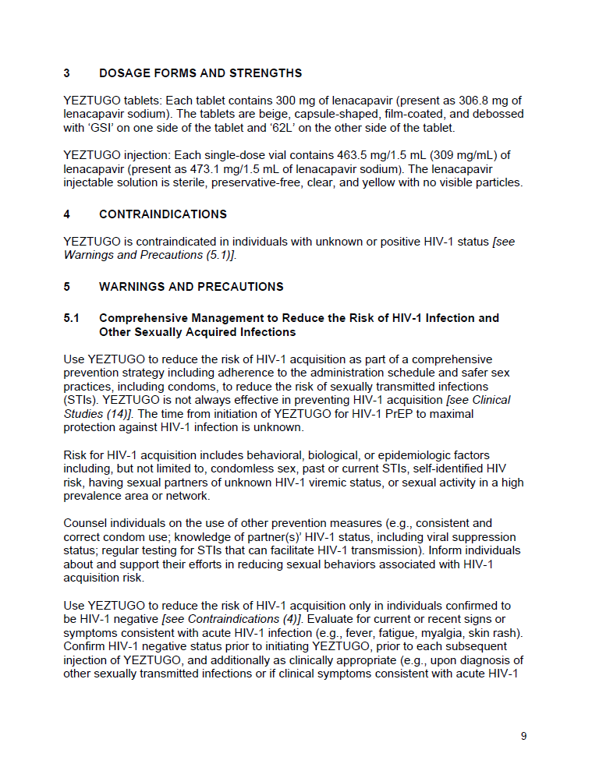
4. Contraindications
4  Contraindications
YEZTUGO is contraindicated in individuals:
With unknown or positive HIV‑1 status.
[see Warnings and Precautions (5.1)]
Notes:
MAIN MESSAGES
LEN is contraindicated in individuals with unknown or positive HIV-1 status

Slide 30
5. Warnings and Precautions
5.1  Comprehensive Management to Reduce the Risk of HIV-1 Infection
and Other Sexually Acquired Infections
Use YEZTUGO to reduce the risk of HIV-1 acquisition as part of a comprehensive prevention strategy including adherence to the administration schedule and safer sex practicesª to reduce the risk of STIs. YEZTUGO is not always effective in preventing HIV-1 acquisition.^{b}
[see Clinical Studies (14)]
Counsel individuals on the use of other prevention measures (e.g., consistent and correct condom use; knowledge of partner(s)’ HIV-1 status, including viral suppression status; regular testing for STIs that can facilitate HIV-1 transmission). Inform individuals about and support their efforts in reducing sexual behaviors associated with HIV-1 acquisition risk.
Counsel and support individuals on adhering to the YEZTUGO administration schedule, on the use of other measures to reduce the risk of STIs and on the importance of routine testing for HIV-1 and other STIs.
ªIncluding condoms; ^{b}The time from initiation of YEZTUGO for HIV-1 PrEP to maximal protection against HIV-1 infection
is unknown
STI, sexually transmitted infection
Notes:
MAIN MESSAGE
YEZTUGO should be used as part of a comprehensive prevention strategy to reduce the risk of HIV-1 and STIs
BACKGROUND
Risk for HIV-1 acquisition includes behavioral, biologic or epidemiologic factors, including, but not limited to, condomless sex, past or current STIs, self-identified HIV risk, having sexual partners with unknown HIV-1 status, or sexual activity in a high prevalence area or network
Use YEZTUGO to reduce the risk of HIV-1 acquisition only in individuals confirmed to be HIV-1 negative [see Contraindications (4)]
Evaluate for current or recent signs or symptoms consistent with acute HIV-1 infection (e.g., fever, fatigue, myalgia, skin rash)
Confirm HIV-1 negative status prior to initiating YEZTUGO, prior to each subsequent injection of YEZTUGO and additionally as clinically appropriate (e.g., upon diagnosis of other STIs or if clinical symptoms consistent with acute HIV-1 infection are present) using a test approved or cleared by the FDA for the diagnosis of acute or primary HIV-1 infection [see Dosage and Administration (2.1)]
It is important to educate on adherence to the YEZTUGO administration schedule, counsel on the use of other measures to reduce the risk of STIs and emphasize the importance of routine testing for HIV and other STIs
Some individuals, such as adolescents, may benefit from additional counseling and appointment reminders to support adherence to the dosing and testing schedule [see Use in Specific Populations (8.4)]

Slide 31
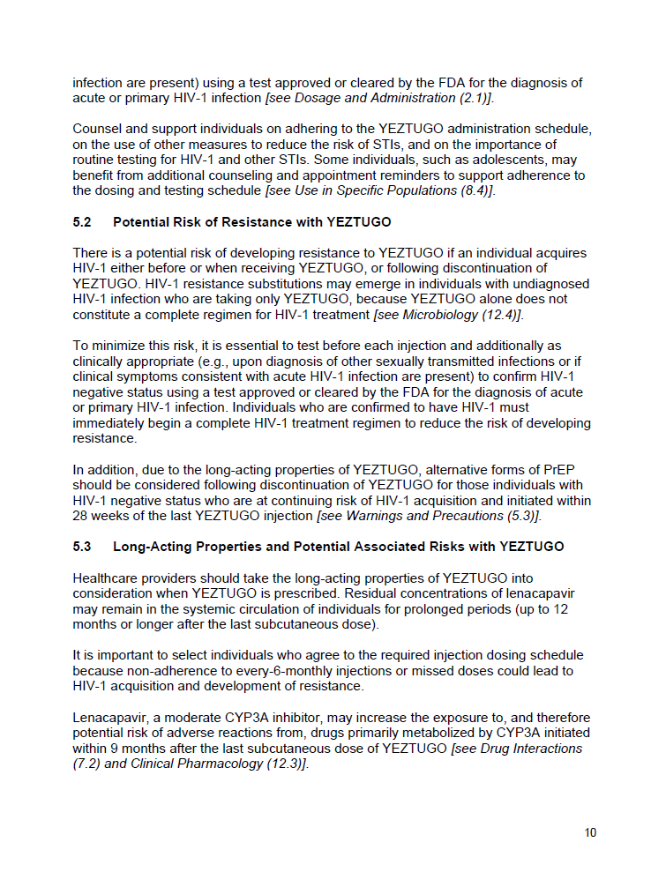
5. Warnings and Precautions
5.2  Potential Risk of Resistance with YEZTUGO
There is a potential risk of developing resistance to YEZTUGO if an individual acquires HIV‑1 either before or when receiving YEZTUGO, or following discontinuation of YEZTUGO. HIV-1 resistance substitutions may emerge in individuals with undiagnosed HIV-1 infection who are taking only YEZTUGO, because YEZTUGO alone does not constitute a complete regimen for HIV-1 treatment. [see Microbiology (12.4)] Test before each injection and additionally as clinically appropriate to confirm HIV-1 negative status.
5.3  Long-Acting Properties and Potential Associated Risks
Healthcare providers should take the long-acting properties of YEZTUGO into consideration when YEZTUGO is prescribed. Residual concentrations of LEN may remain in the systemic circulation of individuals for prolonged periods (up to 12 months or longer after the last
SC dose).
It is important to select individuals who agree to the required injection dosing schedule because nonadherence to Q6M injections or missed doses could lead to HIV-1 acquisition and development of resistance.
Q6M, every 6 months
Notes:
MAIN MESSAGES
There is a potential risk of developing resistance to YEZTUGO if the individual acquires HIV before or when receiving YEZTUGO, or following discontinuation of YEZTUGO
HIV-1 resistance substitutions may emerge in individuals with undiagnosed HIV-1 infection who are taking only YEZTUGO, because YEZTUGO alone does not constitute a complete regimen for HIV-1 treatment
There may be residual concentrations of LEN for up to 12 months or longer after the last SC dose
It is important to select individuals who agree to the required injection dosing schedule because nonadherence to Q6M injections or missed doses could lead to HIV-1 acquisition and development of resistance
BACKGROUND
To minimize the risk of resistance developing, it is essential to test before each injection and additionally as clinically appropriate (e.g., upon diagnosis of other STIs or if clinical symptoms consistent with acute HIV-1 infection are present) to confirm HIV-1 negative status using a test approved or cleared by the FDA for the diagnosis of acute or primary HIV-1 infection
Individuals who are confirmed to have HIV-1 must immediately begin a complete HIV-1 treatment regimen to reduce the risk of developing resistance
In addition, due to the long-acting properties of YEZTUGO, alternative forms of PrEP should be considered following discontinuation of YEZTUGO for those individuals with HIV-1 negative status who are at continuing risk of HIV-1 acquisition and initiated within 28 weeks of the last YEZTUGO injection [see Warnings and Precautions (5.3)]
LEN, a moderate CYP3A inhibitor, may increase the exposure to, and therefore potential risk of adverse reactions from, drugs primarily metabolized by CYP3A initiated within 9 months after the last SC dose of YEZTUGO [see Drug Interactions (7.2) and Clinical Pharmacology (12.3)]

Slide 32
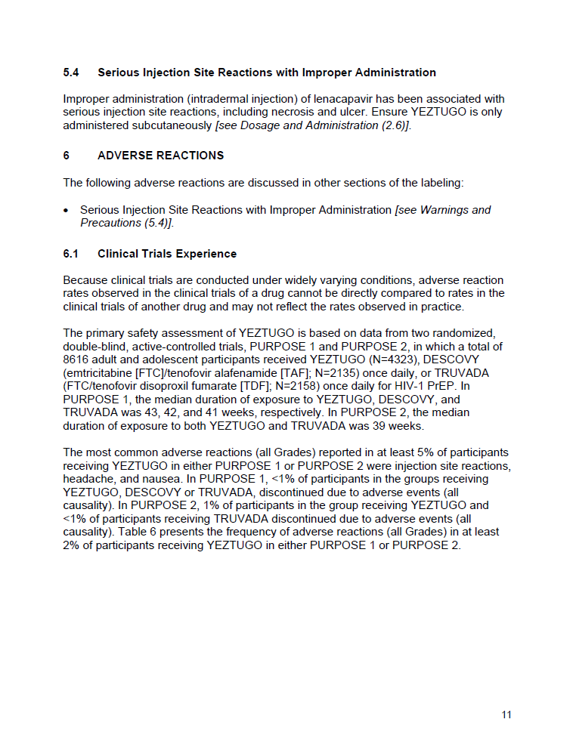
5. Warnings and Precautions
5.4  Serious Injection-Site Reactions With Improper Administration
Improper administration (intradermal injection) of LEN has been associated with serious ISRs, including necrosis and ulcer. Ensure YEZTUGO is only administered subcutaneously.
[see Dosage and Administration (2.6)]
ISR, injection-site reaction
Notes:
MAIN MESSAGES
LEN injection may result in ISRs: nodules, pain, erythema, induration, swelling, bruising, pruritus and warmth
LEN must only be administered subcutaneously; intradermal administration can lead to serious ISRs like necrosis and ulcer
BACKGROUND
SC LEN forms a drug depot whereby LEN is slowly released from the site of administration
The depot formed following YEZTUGO injection may lead to a nodule at the injection site in some individuals [see Adverse Reactions (6.1) and Clinical Pharmacology (12.3)]

Slide 33
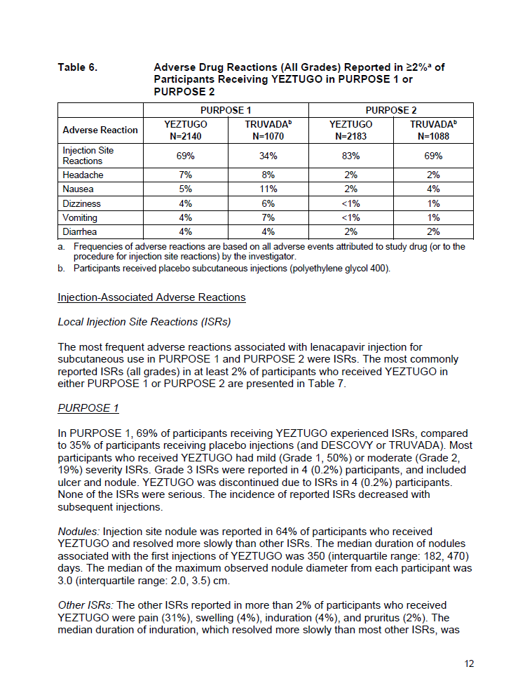
6. Adverse Reactions
6.1  Clinical Trials Experienceª
The most common adverse reactions (all Grades) reported in ≥5% of participants receiving YEZTUGO in either PURPOSE 1 or PURPOSE 2 were ISRs, headache and nausea.
Table 6. Adverse Reactions (All Grades) Reported in ≥2%^{b} of Participants Receiving YEZTUGO in PURPOSE 1 and PURPOSE 2
 | PURPOSE 1 |  | PURPOSE 2
Adverse Reaction | YEZTUGO N=2140 | TRUVADA^{c} N=1070 | YEZTUGO N=2183 | TRUVADA^{c} N=1088
ISRs | 69% | 34% | 83% | 69%
Headache | 7% | 8% | 2% | 2%
Nausea | 5% | 11% | 2% | 4%
Dizziness | 4% | 6% | <1% | 1%
Vomiting | 4% | 7% | <1% | 1%
Diarrhea | 4% | 4% | 2% | 2%
ªBecause clinical trials are conducted under widely varying conditions, adverse reaction rates observed in the clinical trials of a drug cannot be directly compared to rates in the clinical trials of another drug and may not reflect the rates observed in practice; ^{b}Frequencies of adverse reactions are based on all AEs attributed to study drug (or to the procedure for ISRs) by the investigator; ^{c}Participants received placebo SC injections (polyethylene glycol 400);
ISR, injection-site reaction
Notes:
MAIN MESSAGES
The most common adverse reactions (all grades) reported in ≥5% of participants receiving YEZTUGO in either PURPOSE 1 or PURPOSE 2 were ISRs, headache and nausea
BACKGROUND
The primary safety assessment of YEZTUGO is based on data from 2 randomized, double-blind, active-controlled trials, PURPOSE 1 and PURPOSE 2, in which a total of 8616 adult and adolescent participants received YEZTUGO (N=4323), DESCOVY (F/TAF; N=2135) once daily or TRUVADA (F/TDF; N=2158) once daily for HIV-1 PrEP
In PURPOSE 1, the median duration of exposure to YEZTUGO, DESCOVY and TRUVADA was 43, 42 and 41 weeks, respectively
In PURPOSE 2, the median duration of exposure to both YEZTUGO and TRUVADA was 39 weeks

Slide 34
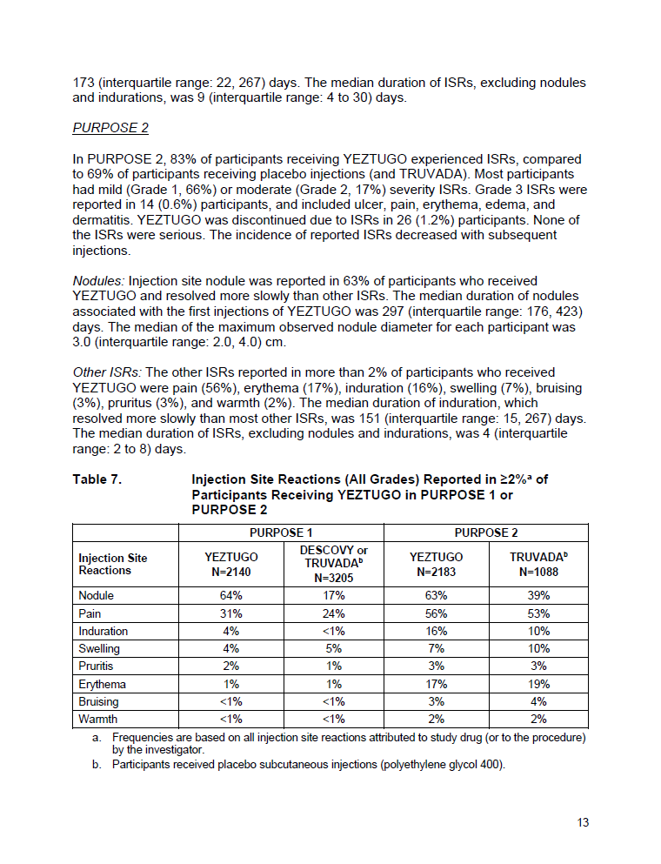
6. Adverse Reactions
6.1  Clinical Trials Experienceª (continued)
Table 7. ISRs (All Grades) Reported in ≥2%^{b} of Participants Receiving YEZTUGO in PURPOSE 1 or PURPOSE 2
 | PURPOSE 1 |  | PURPOSE 2
ISRs | YEZTUGO N=2140 | DESCOVY or TRUVADA^{c} N=3205 | YEZTUGO N=2183 | TRUVADA^{c} N=1088
Nodule | 64% | 17% | 63% | 39%
Pain | 31% | 24% | 56% | 53%
Induration | 4% | <1% | 16% | 10%
Swelling | 4% | 5% | 7% | 10%
Pruritus | 2% | 1% | 3% | 3%
Erythema | 1% | 1% | 17% | 19%
Bruising | <1% | <1% | 3% | 4%
Warmth | <1% | <1% | 2% | 2%
PURPOSE 1:
Grade 3 ISRs were reported in 4 (0.2%) participants
Included ulcer and nodule
PURPOSE 2:
Grade 3 ISRs were reported in 14 (0.6%) participants
Included ulcer, pain, erythema, edema and dermatitis
ªBecause clinical trials are conducted under widely varying conditions, adverse reaction rates observed in the clinical trials of a drug cannot be directly compared to rates in the clinical trials of another drug and may not reflect the rates observed in practice; ^{b}Frequencies are based on all ISRs attributed to study drug (or to the procedure) by the investigator; ^{c}Participants received placebo SC injections (polyethylene glycol 400)
ISR, injection-site reaction
Notes:
TRANSITION
ISRs were the most common AE in the PURPOSE trials
MAIN MESSAGES
In PURPOSE 1, ISRs related to study drug or study procedures occurred in 69% of participants in the LEN group compared with 35% of participants receiving placebo injections (and DESCOVY or TRVUADA)
In PURPOSE 2, ISRs related to study drug or study procedures occurred in 83% of participants in the LEN group compared with 69% of participants receiving placebo injections (and TRUVADA)
BACKGROUND
In PURPOSE 1, most participants who received YEZTUGO had ISRs of mild (Grade 1, 50%) or moderate (Grade 2, 19%) severity
YEZTUGO was discontinued due to ISRs in 4 (0.2%) participants
None of the ISRs were serious
The incidence of reported ISRs decreased with subsequent injections
Injection site nodule was reported in 64% of participants who received YEZTUGO and resolved more slowly than other ISRs
The median duration of nodules associated with the first injections of YEZTUGO was 350 days (IQR: 182–470)
The median of the maximum observed nodule diameter from each participant was 3.0 cm (IQR: 2.0–3.5)
The median duration of induration, which resolved more slowly than most other ISRs, was 173 (interquartile range: 22, 267) days
The median duration of ISRs, excluding nodules and indurations, was 9 (interquartile range: 4 to 30) days
In PURPOSE 2, most participants had ISRs of mild (Grade 1, 66%) or moderate (Grade 2, 17%) severity
YEZTUGO was discontinued due to ISRs in 26 (1.2%) participants
None of the ISRs were serious
The incidence of reported ISRs decreased with subsequent injections
Injection site nodule was reported in 63% of participants who received YEZTUGO and resolved more slowly than other ISRs
The median duration of nodules associated with the first injections of YEZTUGO was 297 days (IQR: 176–423)
The median of the maximum observed nodule diameter for each participant was 3.0 cm (IQR: 2.0–4.0)
The median duration of induration, which resolved more slowly than most other ISRs, was 151 (interquartile range: 15, 267) days
The median duration of ISRs, excluding nodules and indurations, was 4 (interquartile range: 2 to 8) days

Slide 35
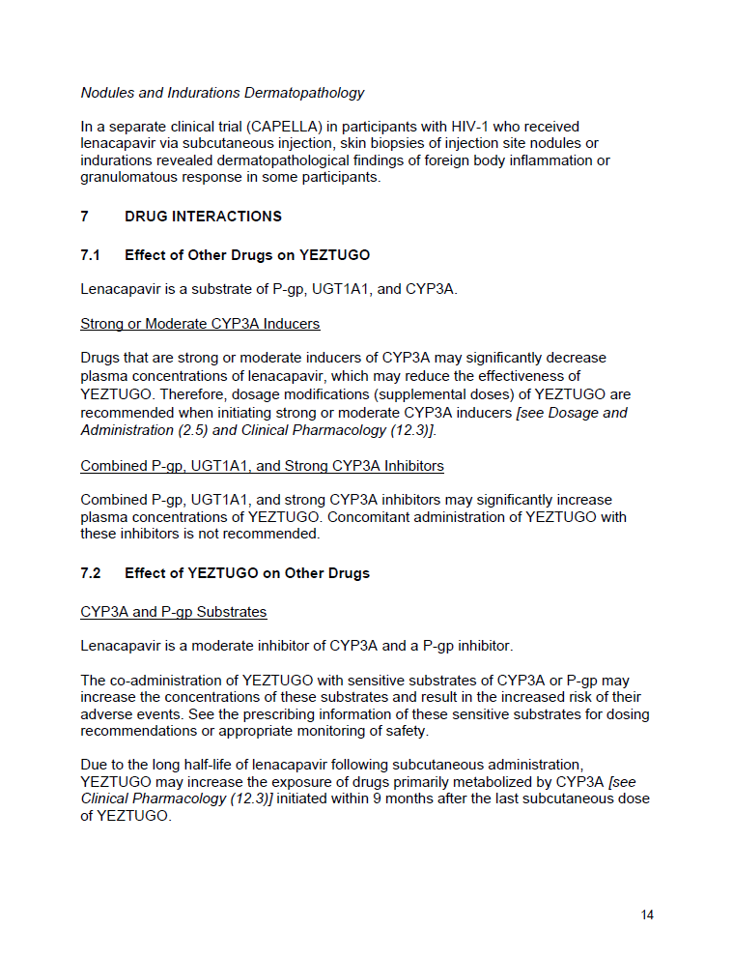
7. Drug Interactions
7.1  Effect of Other Drugs on YEZTUGO
LEN is a substrate of P-gp, UGT1A1 and CYP3A.
Strong or Moderate CYP3A Inducers
  Drugs that are strong or moderate inducers of CYP3A may significantly decrease plasma concentrations of LEN, which may reduce the effectiveness of YEZTUGO. Therefore, dosage modifications (supplemental doses) of YEZTUGO are recommended when initiating strong or moderate CYP3A inducers.
  [see Dosage and Administration (2.5) and Clinical Pharmacology (12.3)]
Combined P-gp, UGT1A1 and Strong CYP3A Inhibitors
  These drugs may significantly increase plasma concentrations of YEZTUGO. Concomitant administration is not recommended.
CYP3A, cytochrome (P450) 3A; P-gp, P-glycoprotein; UGT1A1, UDP-glucuronosyltransferase family 1 member A1
Notes:
MAIN MESSAGES
There are drug–drug interactions that may significantly alter plasma concentrations of LEN/YEZTUGO
Drugs that are strong or moderate inducers of CYP3A may significantly decrease plasma concentrations of LEN
Combined P-gp, UGT1A1 and strong CYP3A inhibitors may significantly increase plasma concentrations of YEZTUGO

Slide 36
7. Drug Interactions
7.2  Effect of YEZTUGO on Other Drugs
  LEN is a moderate inhibitor of CYP3A and a P-gp inhibitor.
  The co-administration of YEZTUGO with sensitive substrates of CYP3A or P-gp may increase the concentrations of these substrates and result in the increased risk of their AEs. See the prescribing information of these sensitive substrates for dosing recommendations or appropriate monitoring of safety.
  Due to the long half-life of LEN following SC administration, YEZTUGO may increase the exposure of drugs primarily metabolized by CYP3A initiated within 9 months after the last SC dose of YEZTUGO. [see Clinical Pharmacology (12.3)]
CYP3A, cytochrome (P450) 3A; P-gp, P-glycoprotein
Notes:
MAIN MESSAGE
There is a potential for increased exposure to drugs metabolized by CYP3A or P-gp, which may lead to adverse reactions
BACKGROUND
See the prescribing information of the sensitive substrates for dosing recommendations or appropriate monitoring of safety

Slide 37
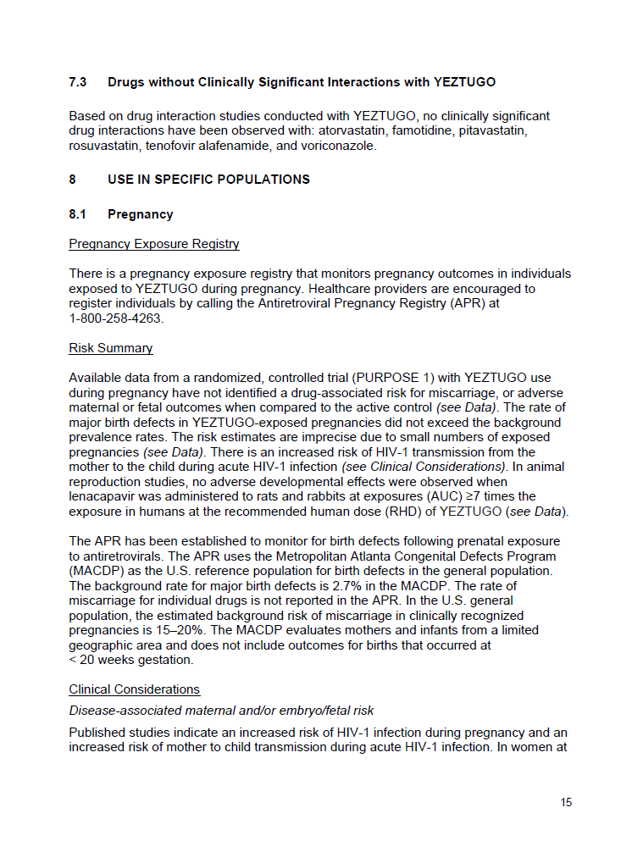
7. Drug Interactions
7.3  Drugs Without Clinically Significant Interactions With YEZTUGO
Based on drug interaction studies conducted with YEZTUGO, no clinically significant drug interactions have been observed, nor are expected, with:
  Atorvastatin
  Famotidine
  Pitavastatin
  Rosuvastatin
  Tenofovir alafenamide
  Voriconazole
Notes:
TRANSITION
Here is a list of common drugs that are not expected to have any clinically significant interactions with LEN
MAIN MESSAGE
As stated

Slide 38
8. Use in Specific Populations
8.1  Pregnancy
Data from PURPOSE 1 have not identified a drug-associated risk for miscarriage, or adverse maternal or fetal outcomes, when compared to the active control. The rate of major birth defects in YEZTUGO-exposed pregnancies did not exceed the background prevalence rates.ª There is an increased risk of HIV-1 transmission from the mother to the child during acute
HIV-1 infection. [see Clinical Considerations]
8.2  Lactation
LEN is present in human milk and was detected at very low levels in infants who were breastfed by individuals who became pregnant while receiving YEZTUGO. No adverse effects of LEN in breastfed infants have been observed.
8.4  Pediatric Use
The safety and effectiveness of YEZTUGO for HIV-1 PrEP in adolescents weighing
≥35 kg who are at risk for HIV-1 acquisition is supported by 2 adequate and well-controlled trials, PURPOSE 1 and PURPOSE 2, that enrolled both adults and adolescents.
[see Adverse Reactions (6.1), Clinical Pharmacology (12.3) and Clinical Studies (14)]
ªThe risk estimates are imprecise due to small numbers of exposed pregnancies
Notes:
MAIN MESSAGES
YEZTUGO has been studied in pregnancy, breastfeeding and adolescence
Adolescents may benefit from additional counseling and appointment reminders to support adherence to the dosing and testing schedule
BACKGROUND
In women without HIV-1 infection, the developmental and health benefits of breastfeeding and the mother’s clinical need for YEZTUGO for HIV-1 PrEP should be considered along with any potential adverse effects on the breastfed child from YEZTUGO and the risk of HIV-1 acquisition due to nonadherence and subsequent mother-to-child transmission
The safety, effectiveness and pharmacokinetics of YEZTUGO in pediatric populations weighing less than 35 kg have not been established

Slide 39
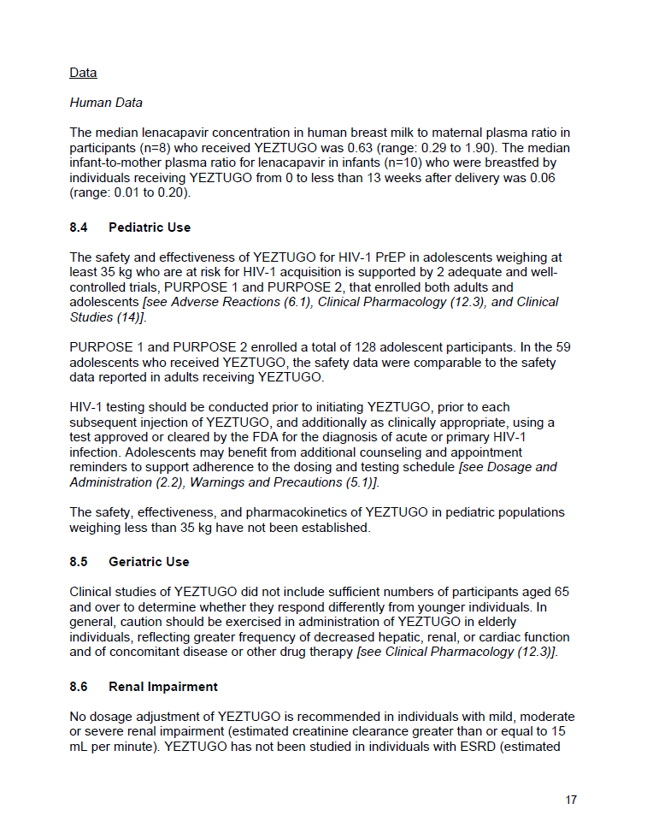
8. Use in Specific Populations
8.5  Geriatric Use
Clinical studies of YEZTUGO did not include sufficient numbers of participants aged
≥65 years to determine whether they respond differently from younger individuals. Exercise caution when administering YEZTUGO in elderly individuals due to greater frequency of decreased hepatic, renal or cardiac function and of concomitant disease or other drug therapy.
[see Clinical Pharmacology (12.3)]
8.6  Renal Impairment
No dosage adjustment of YEZTUGO is recommended in individuals with mild, moderate or severe renal impairment (eCrCl ≥15 mL/min). YEZTUGO has not been studied in individuals with ESRD (eCrCl <15 mL/min). [see Clinical Pharmacology (12.3)]
8.7  Hepatic Impairment
No dosage adjustment of YEZTUGO is recommended in individuals with mild (Child-Pugh Class A) or moderate (Child-Pugh Class B) hepatic impairment. YEZTUGO has not been studied in individuals with severe hepatic impairment (Child-Pugh Class C).
[see Clinical Pharmacology (12.3)]
eCrCl, estimated creatinine clearance; ESRD, end-stage renal disease
Notes:
MAIN MESSAGES
YEZTUGO has not been studied sufficiently in geriatric populations to indicate they respond differently compared with younger individuals
No dosage adjustment of YEZTUGO is recommended for individuals with renal impairment (eCrCl ≥15 mL/min)
No dosage adjustment of YEZTUGO is recommended for individuals with mild or moderate hepatic impairment (Child-Pugh Class A or B, respectively)
BACKGROUND
YEZTUGO has not been studied in individuals with ESRD (eCrCl ≤15 mL/min)
YEZTUGO has not been studied in individuals with severe hepatic impairment (Child-Pugh Class C)

Slide 40
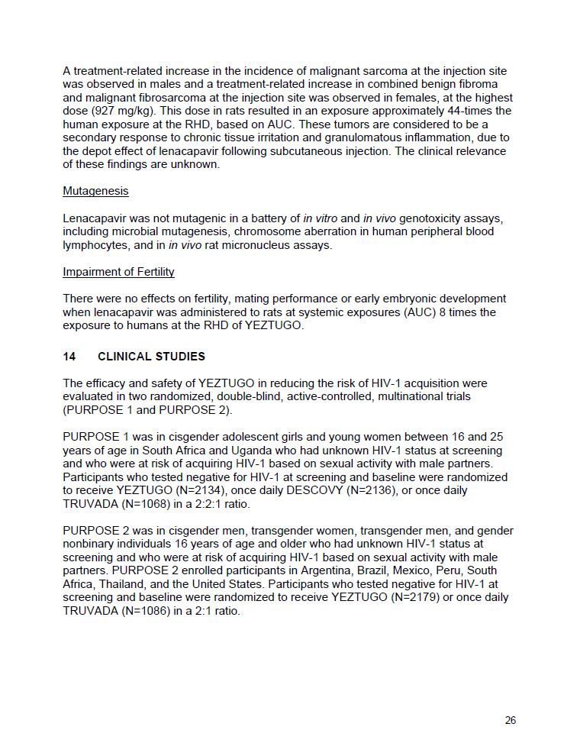
14. Clinical Studies
14  Clinical Studies: PURPOSE 1
Study Design
PURPOSE 1 was in cisgender adolescent girls and young women aged 16–25 years in South Africa and Uganda who had unknown HIV-1 status at screening and were at risk of acquiring HIV-1ª
Participants who tested negative for HIV-1 were randomized to receive YEZTUGO (N=2134), once-daily DESCOVY (N=2136), or once-daily TRUVADA (N=1068) in a 2:2:1 ratio
The use of DESCOVY (F/TAF) for the prevention of HIV in cisgender women is not approved.
The safety and efficacy of this use have not been established
Baseline Characteristics
Outcomes/Results at Primary Analysis
HIV incidence per 100/PY was compared between participants receiving YEZTUGO and TRUVADA
YEZTUGO demonstrated superiority over TRUVADA, with a 100% reduction in the risk of incident HIV-1 infection (Table 13; see next slide)
YEZTUGO also demonstrated superiority in the risk of incident HIV-1 infection over bHIV
Median participant age:
21 years
(range: 16‒26)
Baseline characteristics in the randomized participants were similar to those in the screened population
of participants
were Black
99.9%
ªBased on sexual activity with male partners
bHIV, background HIV incidence; F/TAF, emtricitabine/tenofovir alafenamide; PY, person-years
Notes:
MAIN MESSAGES
The efficacy and safety of YEZTUGO in reducing the risk of HIV-1 acquisition were evaluated in 2 randomized, double-blind, active-controlled, multinational trials (PURPOSE 1 and PURPOSE 2)
Efficacy at primary analysis
YEZTUGO demonstrated superiority over TRUVADA, with a 100% reduction in the risk of incident HIV-1 infection
YEZTUGO also demonstrated superiority in the risk of incident HIV-1 infection over bHIV
BACKGROUND
Baseline characteristics in the randomized participants were similar to those in the screened population

Slide 41
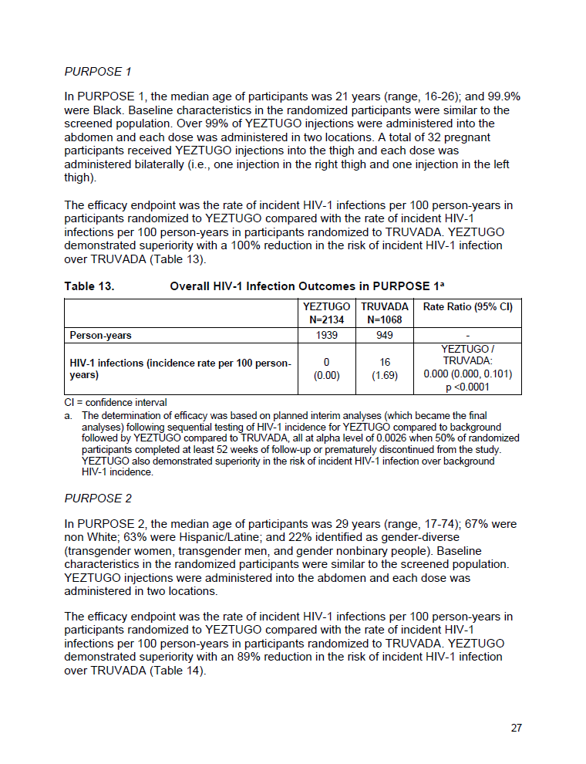
14. Clinical Studies
14  Clinical Studies: PURPOSE 1 (continued)
Table 13. Overall HIV-1 Incidence Outcomes in PURPOSE 1ª
 | YEZTUGO N=2134 | TRUVADA N=1068 | Rate Ratio (95% CI)
Person-years | 1939 | 949 | –
HIV-1 infections (incidence rate per 100 person-years) | 0 (0.00) | 16 (1.69) | YEZTUGO / TRUVADA: 0.000 (0.000, 0.101) P<0.0001
  There were 2 incident infections^{b} among participants in the YEZTUGO arm of the PURPOSE 1 trial. Both occurred after the time of the primary analysis:
  1 occurred in a participant after LEN exposures fell below the target concentration following discontinuation of YEZTUGO, and virus from this participant had no LEN resistance-associated capsid substitutions
  1 occurred in a participant with viral loads that were too low for genotyping
ªThe determination of efficacy was based on planned interim analyses (which became the final analyses) following sequential testing of HIV-1 incidence for YEZTUGO compared to background followed by YEZTUGO compared to TRUVADA; all at alpha level of 0.0026 when 50% of randomized participants completed at least 52 weeks of follow-up or prematurely discontinued from the study; ^{b}Infections that occurred after starting YEZTUGO for HIV-1 PrEP
Notes:
TRANSITION
YEZTUGO demonstrated superiority with a 100% reduction in risk of incident HIV-1 infection over TRUVADA at primary analysis
MAIN MESSAGE
Of 2134 participants who received YEZTUGO, none acquired HIV
BACKGROUND
In addition to 2 incident infections that occurred after the time of the primary analysis, there were 4 prevalent infections (acute infection at baseline identified after starting YEZTUGO for HIV-1 PrEP) among participants in the YEZTUGO arm of the PURPOSE 1 trial
Viruses with LEN resistance-associated capsid substitutions were detected in 3 of the 4 participants with prevalent infections, 2 with N74D and 1 with T107A

Slide 42

14. Clinical Studies
14  Clinical Studies: PURPOSE 2
Study Design
PURPOSE 2 was in cisgender men, transgender women, transgender men and gender-nonbinary individuals aged ≥16 years with unknown HIV-1 status at screening and at risk of acquiring HIV-1ª
PURPOSE 2 enrolled participants in Argentina, Brazil, Mexico, Peru, South Africa, Thailand and the US
Participants who tested negative for HIV-1 were randomized to receive YEZTUGO (N=2179) or once-daily TRUVADA (N=1086) in a 2:1 ratio
Baseline Characteristics
Outcomes/Results at Primary Analysis
HIV incidence per 100/PY was compared between participants receiving YEZTUGO and TRUVADA
YEZTUGO demonstrated superiority over TRUVADA, with an 89% reduction in the risk of incident HIV-1 infection (Table 14; see next slide)
YEZTUGO also demonstrated superiority in the risk of incident HIV-1 infection over bHIV
Baseline characteristics
in the randomized participants were similar to those in the screened population
Median participant age:
29 years
(range: 17‒74)
b
ªBased on sexual activity with male partners; ^{b}Transgender women, transgender men and gender-nonbinary people
bHIV, background HIV incidence; PY, person-years
Notes:
MAIN MESSAGES
YEZTUGO demonstrated superiority over TRUVADA, with an 89% reduction in the risk of incident HIV-1 infection at the primary analysis
YEZTUGO also demonstrated superiority in the risk of incident HIV-1 infection over bHIV
BACKGROUND
Baseline characteristics in the randomized participants were similar to those in the screened population

Slide 43
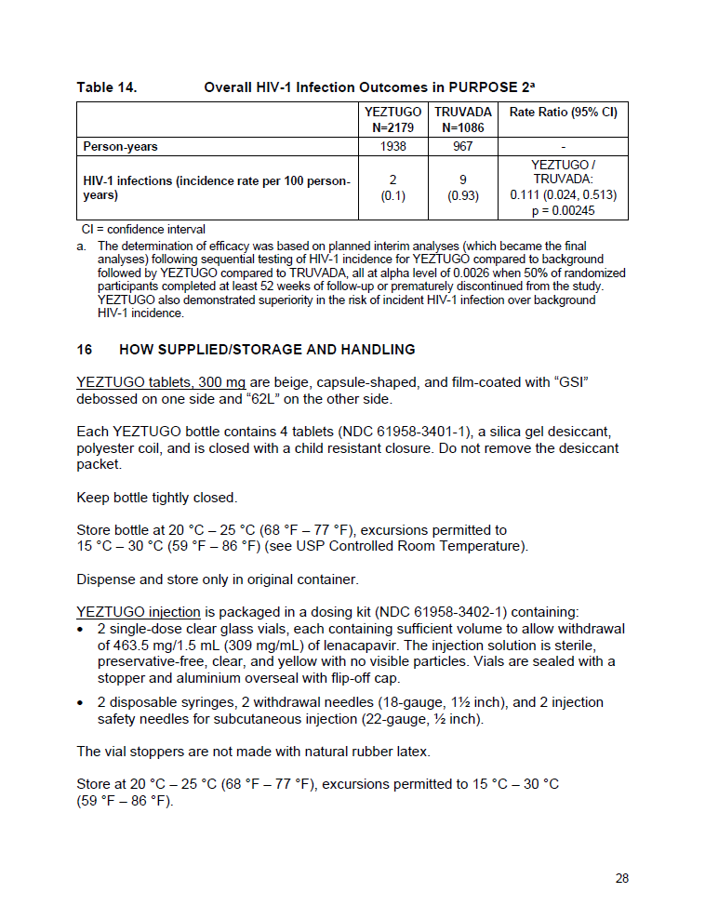
14. Clinical Studies
14  Clinical Studies: PURPOSE 2 (continued)
Table 14. Overall HIV-1 Incidence Outcomes in PURPOSE 2ª
 | YEZTUGO N=2179 | TRUVADA N=1086 | Rate Ratio (95% CI)
Person-years | 1938 | 967 | -
HIV-1 infections (incidence rate per 100 person-years) | 2 (0.1) | 9 (0.93) | YEZTUGO / TRUVADA: 0.111 (0.024, 0.513) P=0.00245
  There were 3 incident infections^{b} among participants in the YEZTUGO arm of the
  PURPOSE 2 trial:
  1 occurred after the time of primary analysis
  LEN resistance-associated substitutions were detected in viruses from all 3 participants: 2 with N74D, and
  1 with Q67H/K70R
ªThe determination of efficacy was based on planned interim analyses (which became the final analyses) following sequential testing of HIV-1 incidence for YEZTUGO compared to background followed by YEZTUGO compared to TRUVADA; all at alpha level of 0.0026 when 50% of randomized participants completed at least 52 weeks of follow-up or prematurely discontinued from the study; ^{b}Infections that occurred after starting YEZTUGO for HIV-1 PrEP
Notes:
TRANSITION
YEZTUGO demonstrated superiority over TRUVADA, with an 89% reduction in the risk of incident HIV-1 infection at the time of primary analysis
MAIN MESSAGE
In 2179 participants who received YEZTUGO in the PURPOSE 2 trial, only 3 acquired HIV. One of these incident infections occurred after the time of the primary analysis
BACKGROUND
In addition to 3 incident infections, there were 4 prevalent infections (acute infection at baseline identified after starting YEZTUGO for HIV-1 PrEP) among participants in the YEZTUGO arm of the PURPOSE 2 trial
Genotypic data were available for 3 of the 4 participants with prevalent infections
Viruses with LEN resistance-associated capsid substitutions were detected in 2 of these 3 participants, both with N74D

Slide 44
Appendix
Notes:
The slides contained in the Appendix section are optional

Slide 45
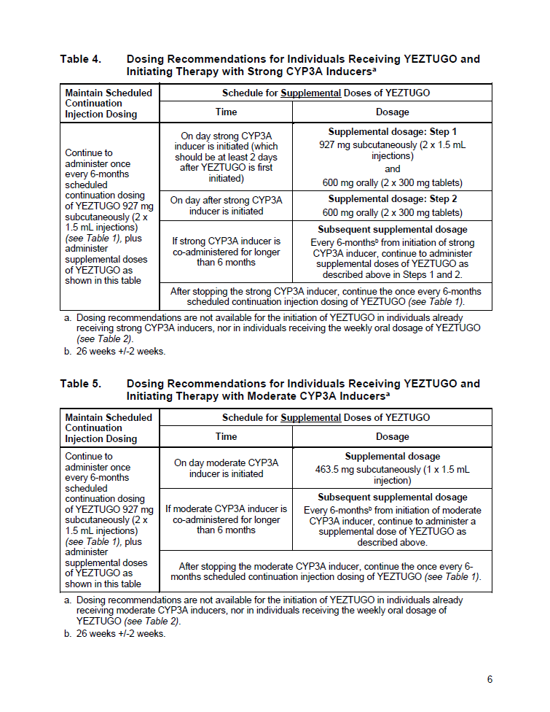
2. Dosage and Administration
2.5  Dosage Modifications for Co-administration with Strong or Moderate CYP3A Inducers
Table 4. Dosing Recommendations for Individuals Receiving YEZTUGO and Initiating Therapy with Strong CYP3A Inducersª
Maintain Scheduled Continuation Injection Dosing | Schedule for Supplemental Doses of YEZTUGO
Continue to administer once Q6M scheduled continuation dosing of YEZTUGO (see Table 1), plus administer supplemental doses of YEZTUGO as shown here: | Time | Dosage
 | On day strong CYP3A inducer is initiated (≥2 days after YEZTUGO is first initiated) | Supplemental dosage: Step 1 927 mg subcutaneously (2 × 1.5 mL injections) and 600 mg orally (2 × 300 mg tablets)
 | On day after strong CYP3A inducer is initiated | Supplemental dosage: Step 2 600 mg orally (2 × 300 mg tablets)
 | If strong CYP3A inducer is co-administered for >6 months | Subsequent supplemental dosage Q6M^{b} from initiation of strong CYP3A inducer, continue to administer supplemental doses of YEZTUGO as described above in Steps 1 and 2
 | After stopping the strong CYP3A inducer, continue the Q6M scheduled continuation injection dosing of YEZTUGO (see Table 1)
ªDosing recommendations are not available for the initiation of YEZTUGO in individuals already receiving moderate CYP3A inducers, nor in individuals receiving the weekly oral dosage of YEZTUGO (see Table 2); ^{b}26 weeks ±2 weeks
CYP3A, cytochrome (P450) 3A; Q6M, every 6 months
Notes:
Optional Slide
TRANSITION
Dosage modifications are recommended for co-administration with strong CYP3A inducers, as displayed on the slide

Slide 46
2. Dosage and Administration
2.5  Dosage Modifications for Co-administration with Strong or Moderate CYP3A Inducers
Table 5. Dosing Recommendations for Individuals Receiving YEZTUGO and Initiating Therapy with Moderate CYP3A Inducersª
Maintain Scheduled Continuation Injection Dosing | Schedule for Supplemental Doses of YEZTUGO
Continue to administer once Q6M scheduled continuation dosing of YEZTUGO (see Table 1), plus administer supplemental doses of YEZTUGO as shown here: | Time | Dosage
 | On day moderate CYP3A inducer is initiated | Supplemental dosage 463.5 mg subcutaneously (1 × 1.5 mL injection)
 | If moderate CYP3A inducer is co-administered for >6 months | Subsequent supplemental dosage Q6M^{b} from initiation of moderate CYP3A inducer, continue to administer a supplemental dose of YEZTUGO as described above
 | After stopping the moderate CYP3A inducer, continue the Q6M scheduled continuation injection dosing of YEZTUGO (see Table 1)
ªDosing recommendations are not available for the initiation of YEZTUGO in individuals already receiving moderate CYP3A inducers, nor in individuals receiving the weekly oral dosage of YEZTUGO (see Table 2); ^{b}26 weeks ±2 weeks
CYP3A, cytochrome (P450) 3A; Q6M, every 6 months
Notes:
Optional Slide
TRANSITION
Dosage modifications are recommended for co-administration with moderate CYP3A inducers, as displayed on the slide

Slide 47
2. Dosage and Administration
The indicated dosage for YEZTUGO is 927 mg by 2 × 1.5 mL SC injections and 600 mg orally on Day 1; 600 mg orally on Day 2; and 927 mg by 2 × 1.5 mL SC injections every
6 months thereafter
QUESTION 1
TRUE
FALSE
OR
Notes:
The purpose of the quiz questions is to generate discussion for the speaker. These are optional

Slide 48
2. Dosage and Administration
The indicated dosage for YEZTUGO is 927 mg by 2 × 1.5 mL SC injections and 600 mg orally on Day 1; 600 mg orally on Day 2; and 927 mg by 2 × 1.5 mL SC injections every
6 months thereafter
QUESTION 1
TRUE
⧫
  TRUE. Please refer to section 2.3 of the USPI for further information
Notes:
The purpose of the quiz questions is to generate discussion for the speaker. These are optional

Slide 49
2. Dosage and Administration
This dose is indicated in adults and adolescents weighing ≥25 kg
QUESTION 2
TRUE
FALSE
OR
Notes:
The purpose of the quiz questions is to generate discussion for the speaker. These are optional

Slide 50
2. Dosage and Administration
This dose is indicated in adults and adolescents weighing ≥25 kg
QUESTION 2
FALSE
◆
FALSE. This dose is indicated in adults and adolescents weighing ≥35 kg
  Please refer to section 2.3 of the USPI for further information
Notes:
The purpose of the quiz questions is to generate discussion for the speaker. These are optional

Slide 51
2. Dosage and Administration
YEZTUGO should be injected into the subcutaneous space at a 45–90° angle
(preferably 90°)
QUESTION 3
TRUE
FALSE
OR
Notes:
The purpose of the quiz questions is to generate discussion for the speaker. These are optional

Slide 52
2. Dosage and Administration
YEZTUGO should be injected into the subcutaneous space at a 45–90° angle
(preferably 90°)
QUESTION 3
TRUE
⧫
  TRUE. YEZTUGO injection is only for SC administration into the abdomen by a healthcare provider, and a 90-degree angle is preferred. The thigh can be used as an alternative injection site if preferred. Do NOT administer intradermally due to risk of serious ISRs
  Please refer to section 2.6 of the USPI for further information
ISR, injection-site reaction
Notes:
The purpose of the quiz questions is to generate discussion for the speaker. These are optional

Slide 53
2. Dosage and Administration
Two different needles are provided in the YEZTUGO kit. One is for withdrawal
and one is for injection
QUESTION 4
TRUE
FALSE
OR
Notes:
The purpose of the quiz questions is to generate discussion for the speaker. These are optional

Slide 54
2. Dosage and Administration
Two different needles are provided in the YEZTUGO kit. One is for withdrawal
and one is for injection
QUESTION 4
TRUE
⧫
  TRUE. The 18-gauge needle is used for withdrawal
  and a 22-gauge needle is used for injection
  Please refer to section 2.6 of the USPI for further information
Notes:
The purpose of the quiz questions is to generate discussion for the speaker. These are optional

Slide 55
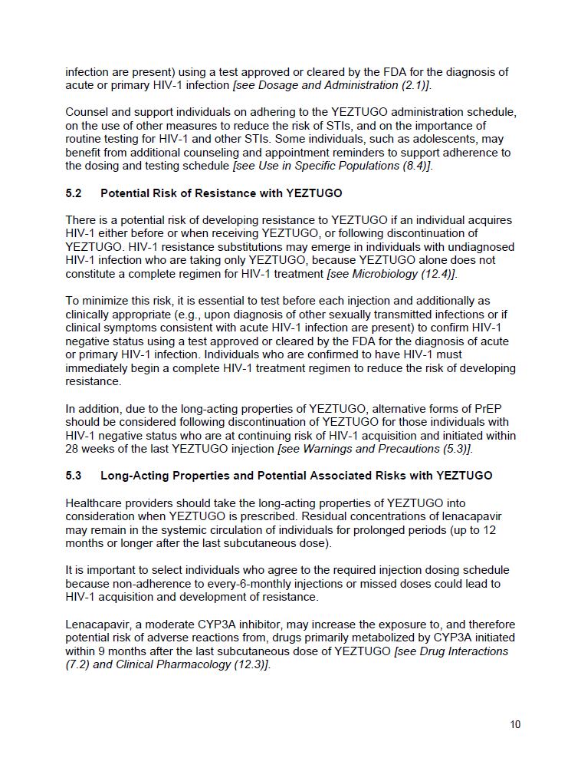
5. Warnings and Precautions
YEZTUGO alone does not constitute a complete regimen for HIV‑1 treatment
QUESTION 5
TRUE
FALSE
OR
Notes:
The purpose of the quiz questions is to generate discussion for the speaker. These are optional

Slide 56
5. Warnings and Precautions
YEZTUGO alone does not constitute a complete regimen for HIV‑1 treatment
QUESTION 5
TRUE
⧫
  TRUE. Individuals who are confirmed to have HIV-1 must immediately begin a complete HIV-1 treatment regimen to reduce the risk of developing resistance
  Please refer to section 5.2 of the USPI for further information
Notes:
The purpose of the quiz questions is to generate discussion for the speaker. These are optional

Slide 57
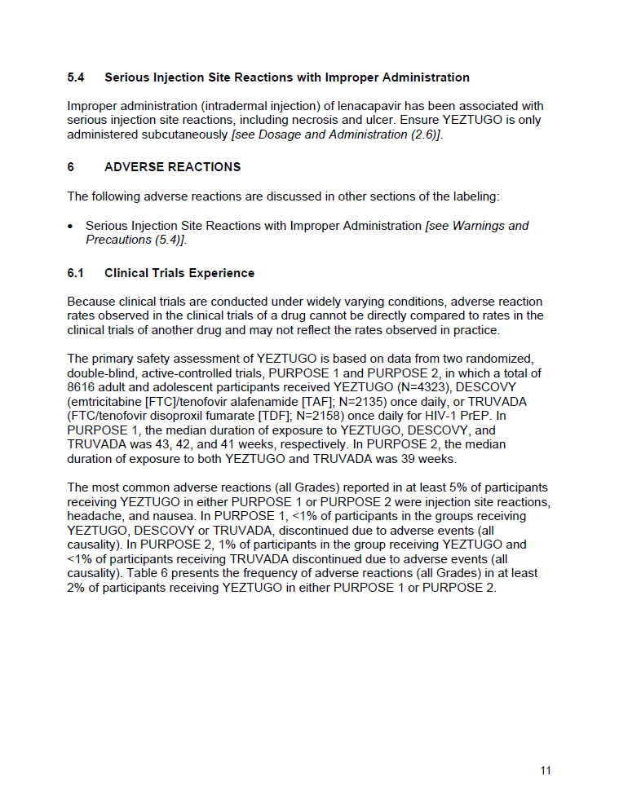
5. Warnings and Precautions
Improper administration (ex. intradermal injection) of LEN has been associated
with serious ISRs, including necrosis and ulcer
QUESTION 6
TRUE
FALSE
OR
ISR, injection-site reaction
Notes:
The purpose of the quiz questions is to generate discussion for the speaker. These are optional

Slide 58
5. Warnings and Precautions
Improper administration (ex. intradermal injection) of LEN has been associated
with serious ISRs, including necrosis and ulcer
QUESTION 6
TRUE
⧫
TRUE. Ensure YEZTUGO is only administered subcutaneously
Please refer to sections 5.4 and 2.6 of the USPI for further information
ISR, injection-site reaction
Notes:
The purpose of the quiz questions is to generate discussion for the speaker. These are optional

Slide 59
7. Drug Interactions
YEZTUGO is a moderate inhibitor of CYP3A and a P-gp inhibitor
QUESTION 7
TRUE
FALSE
OR
CYP3A, cytochrome (P450) 3A; P-gp, P-glycoprotein
Notes:
The purpose of the quiz questions is to generate discussion for the speaker. These are optional

Slide 60
7. Drug Interactions
YEZTUGO is a moderate inhibitor of CYP3A and a P-gp inhibitor
QUESTION 7
TRUE
⧫
  TRUE. Please refer to section 7.2 of the USPI for further information
CYP3A, cytochrome (P450) 3A; P-gp, P-glycoprotein
Notes:
The purpose of the quiz questions is to generate discussion for the speaker. These are optional

Slide 61
YEZTUGO® (lenacapavir) for HIV-1 PrEP
Navigating the US Prescribing Information
Notes:
Guidance for Deck Usage:​
The deck must be presented sequentially and skipping sections is not permitted; all slides are required except for the quiz questions and appendix slides which are optional
The purpose of the quiz questions is to generate discussion for the speaker. These are optional
The slides contained in the appendix section are optional
​
Guidance for Distribution: The distributed version must include all slides.

